Slide 1
图像盲复原：从模型学习到深度网络
任冬伟
天津大学
2019年6月10日

Slide 2
Outline
Background
Discriminative Learning of Iteration-wise Priors for Blur Kernel Estimation
Learning Robust Non-Blind Deconvolution Models
Self-Learning for Blind Deconvolution

Slide 3
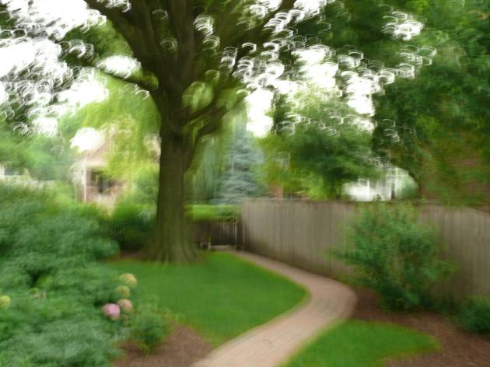
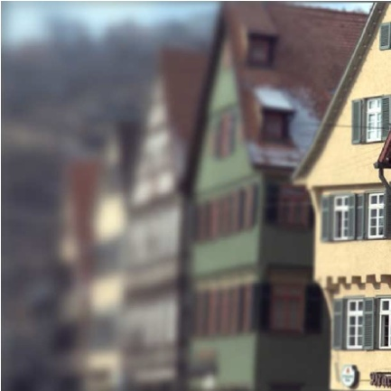
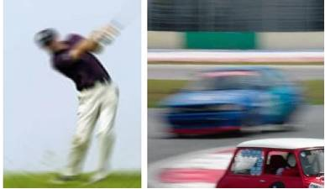
Image Restoration

Slide 4
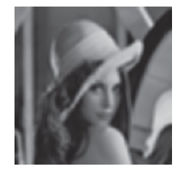
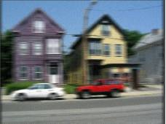
Modeling Image Degradation
Uniform blur + Noise
  Space invariant PSF -> convolution
Non-uniform blur + Noise
  Image defocus
  Camera shake

Slide 5
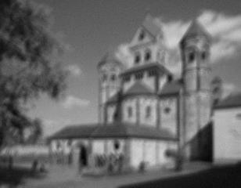
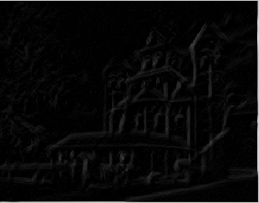
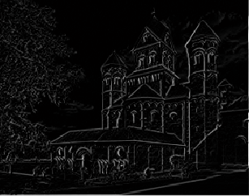

MAP-based Deblur
Estimate blur kernel
Non-blind restoration
Blurry image
iterate
need image prior
need image prior
estimate clean image
estimate blur kernel
Deblurred image

Slide 6
Related Works
Conventional optimization-based methods
Estimating blur kernel relies on salient edge selection
  l₀-norm, l₁/l₂-norm, patch prior, dark channel prior
  Bilateral filter/shock filter
Blur kernel estimation error
  Existing non-blind restoration methods are based on error-free kernel assumption

Slide 7
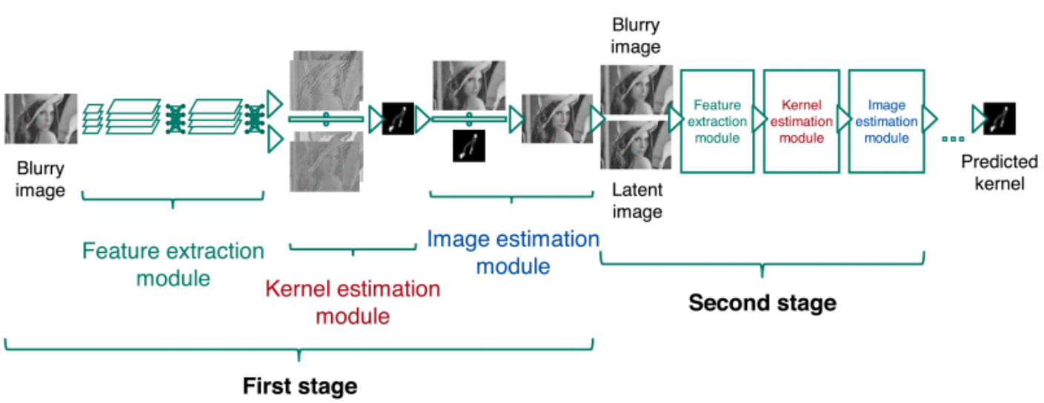
Related Works
Learning to Deblur, TPAMI 2016

Slide 8
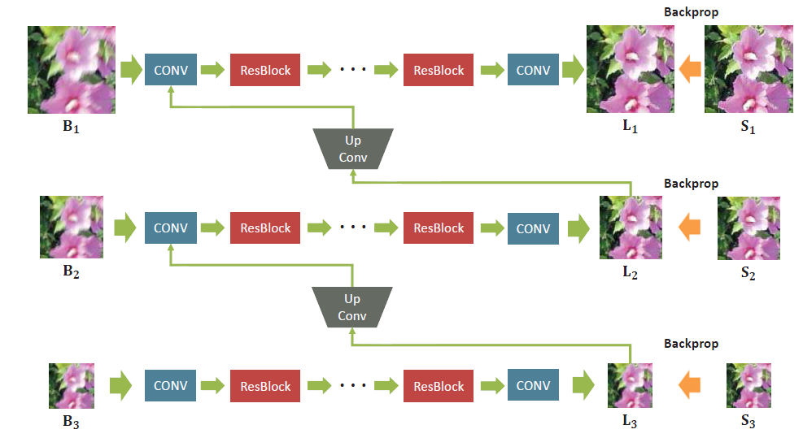
Related Works
Deep multi-scale convolutional neural network for dynamic scene deblurring, CVPR 2017

Slide 9
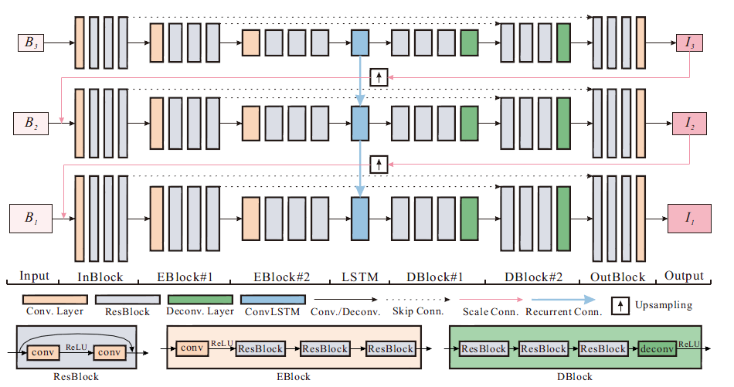
Related Works
Scale-recurrent network for deep image deblurring, CVPR 2018

Slide 10
Outline
Background
Discriminative Learning of Iteration-wise Priors for Blur Kernel Estimation
Learning Robust Non-Blind Deconvolution Models
Self-Learning for Blind Deconvolution

Slide 11
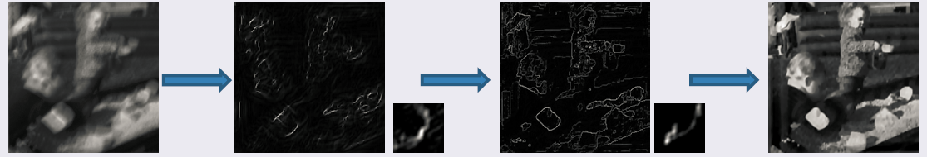
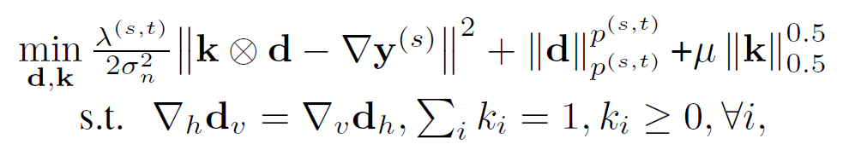
Iteration-wise priors
Model gradients as hyper-Laplacian distributions
Gradient sparsity should reduce during kernel estimation
Iteration-wise image priors-based model
Learning Iteration-wise Generalized Shrinkage-Thresholding Operators for Blind Deconvolution, IEEE TIP 2016

Slide 12
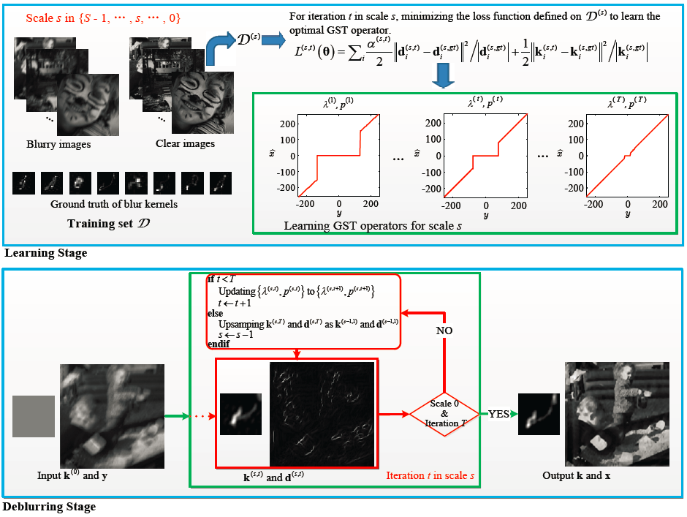

Slide 13
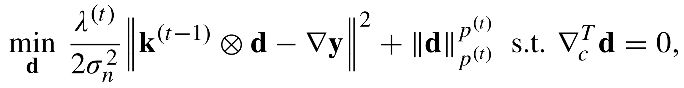
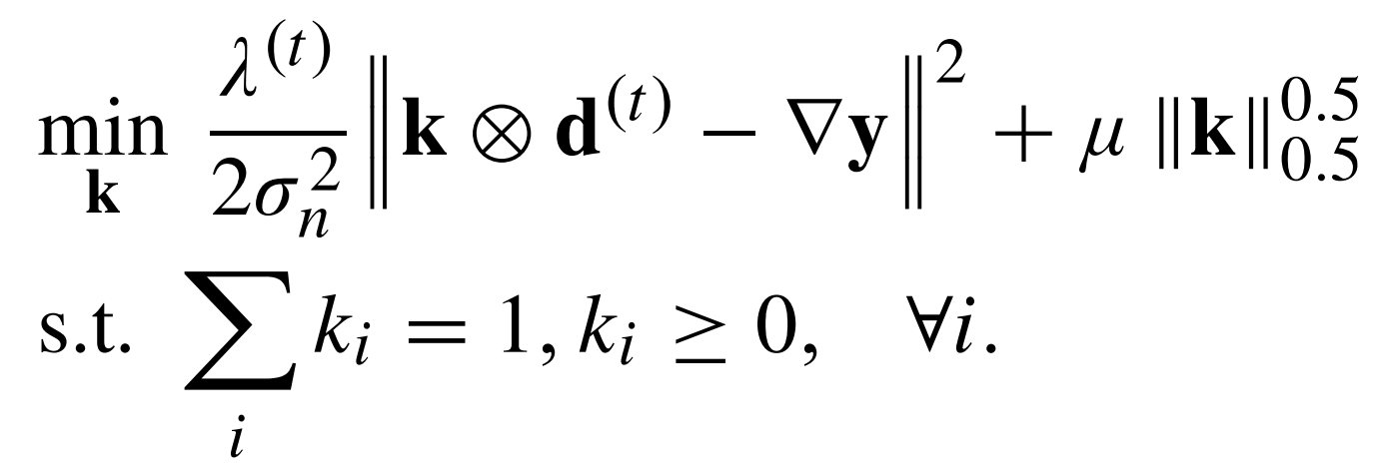
Iterative optimization
Fixing k, update d via Hybrid D-ADMM
  One step GST operator (Zuo et al., 2013)
Fixing d, update k via one step ALM

Slide 14
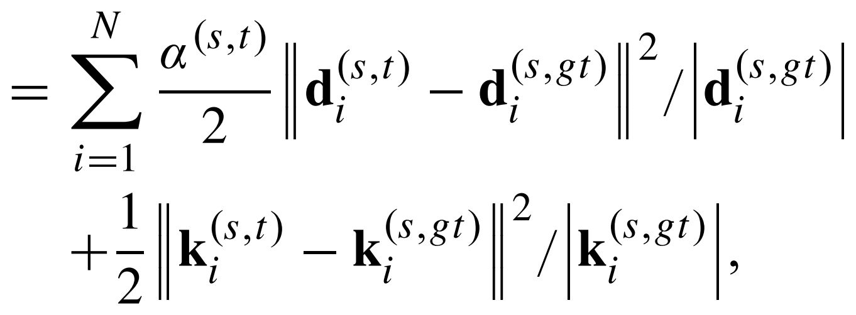
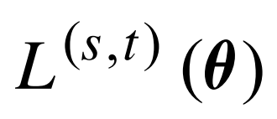
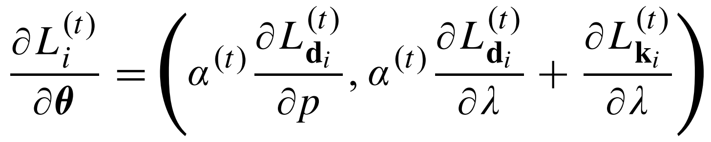
Training
Loss function
Optimization：gradient descent

Slide 15
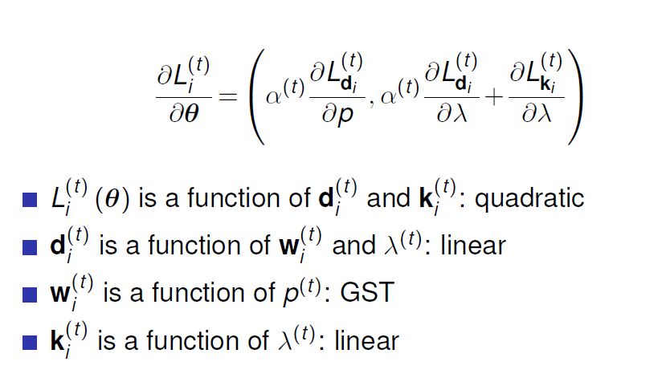
Training

Slide 16
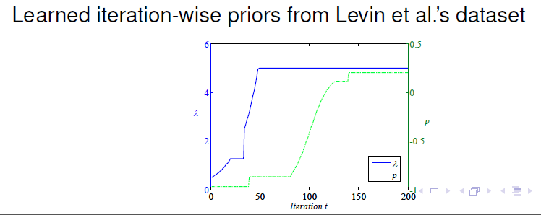
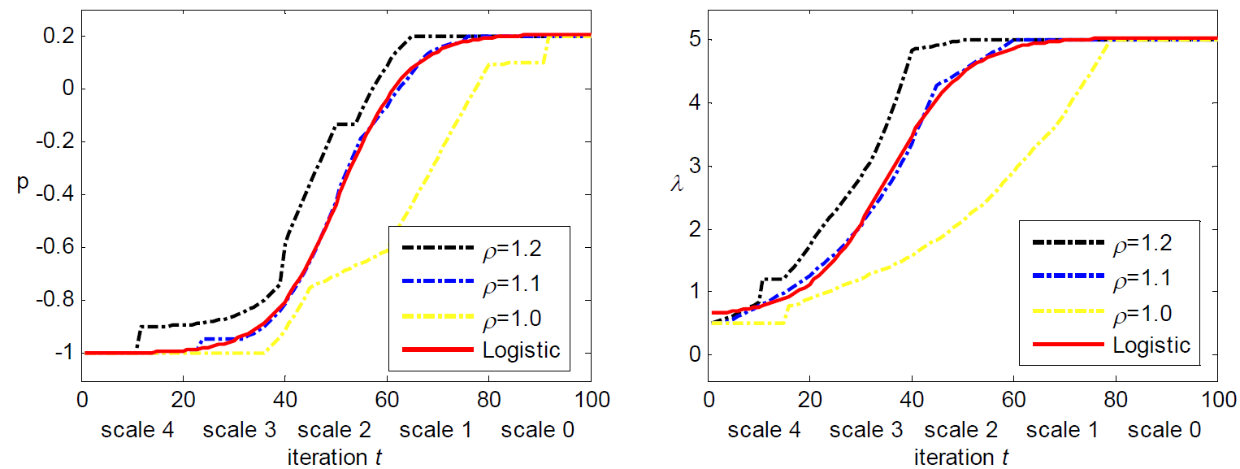

Slide 17
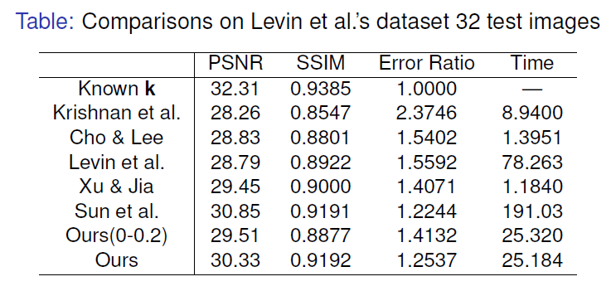
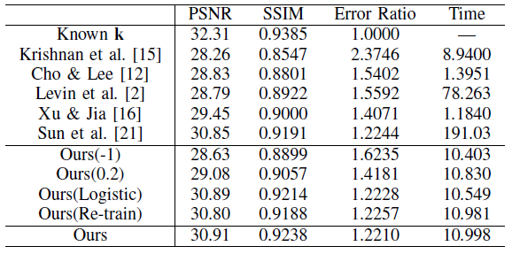
Results

Slide 18
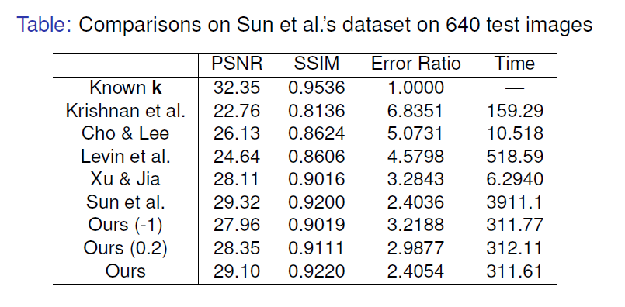
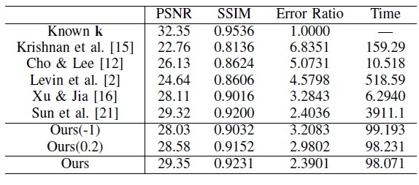
Results

Slide 19
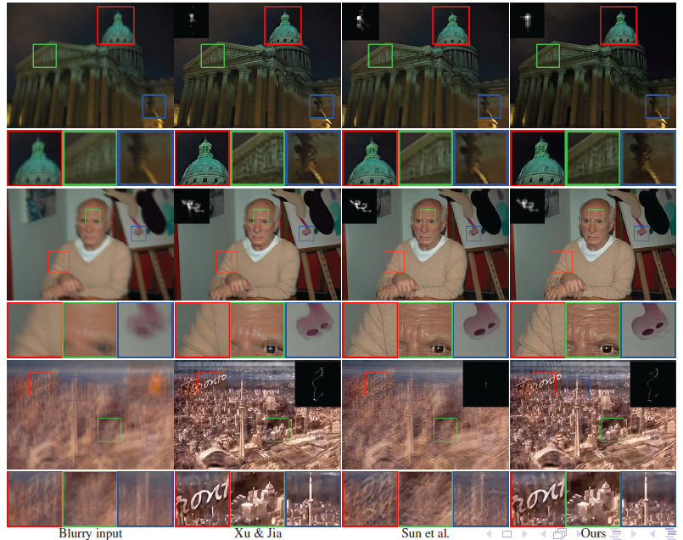

Slide 20
Outline
Background
Discriminative Learning of Iteration-wise Priors for Blur Kernel Estimation
Learning Robust Non-Blind Deconvolution Models
Self-Learning for Blind Deconvolution

Slide 21
Non-blind Deconvolution
Blur kernel estimation error is hard to model directly.

Slide 22
Motivation
Existing methods focus on C, i.e., image priors
Gradient: l₁-norm, l_{p}-norm
Large filter: FOE, CSF
Patch: EPLL, NCSR
CNN: IRCNN
When k is not accurate, λ should be large, yielding over-smooth results
Key step

Slide 23
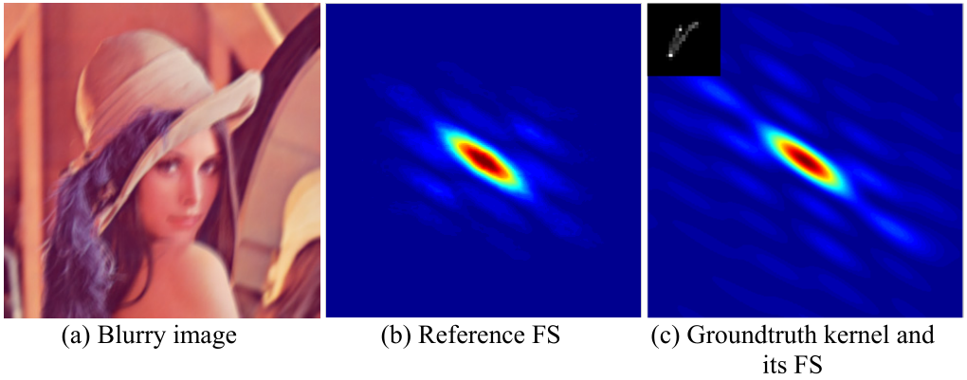
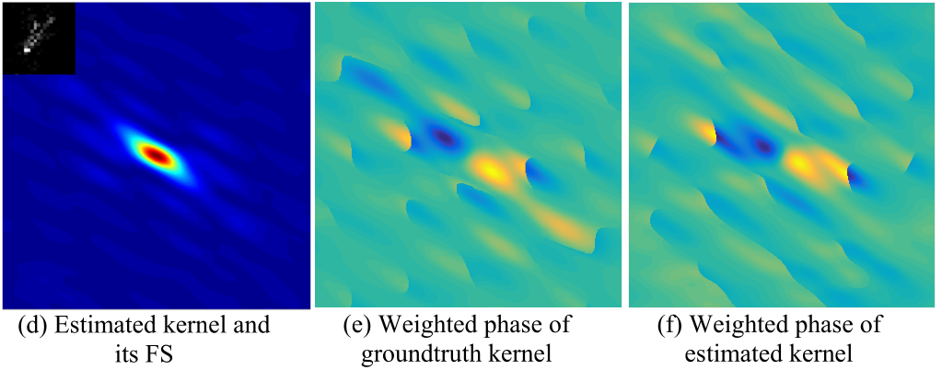
Partial Deconvolution
Only reliable Fourier coefficients are used during deconvolution
Partial Deconvolution with Inaccurate Blur Kernel, IEEE TIP 2018

Slide 24
Partial Deconvolution
Partial convolution: partial map Ω
By MAP estimation

Slide 25
E-M framework
E step: estimate the expectation of partial map
M step: given current partial map, updating clear image

Slide 26
Partial Deconvolution

Slide 27

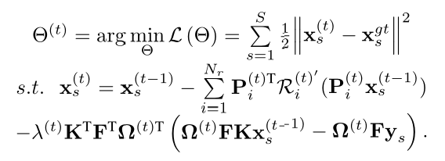
Partial Deconvolution

Slide 28
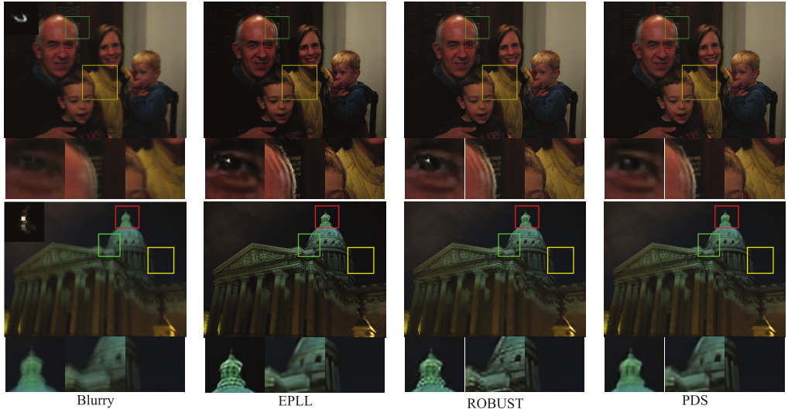
Results
Blurry EPLL ROBUST Partial Deconvolution

Slide 29
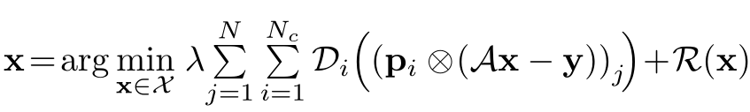

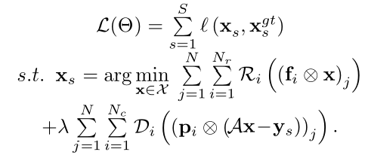
Simultaneous Fidelity and Regularization Learning
Fidelity
Regularization
Simultaneous Fidelity and Regularization Learning for Image Restoration, IEEE TPAMI 2019

Slide 30
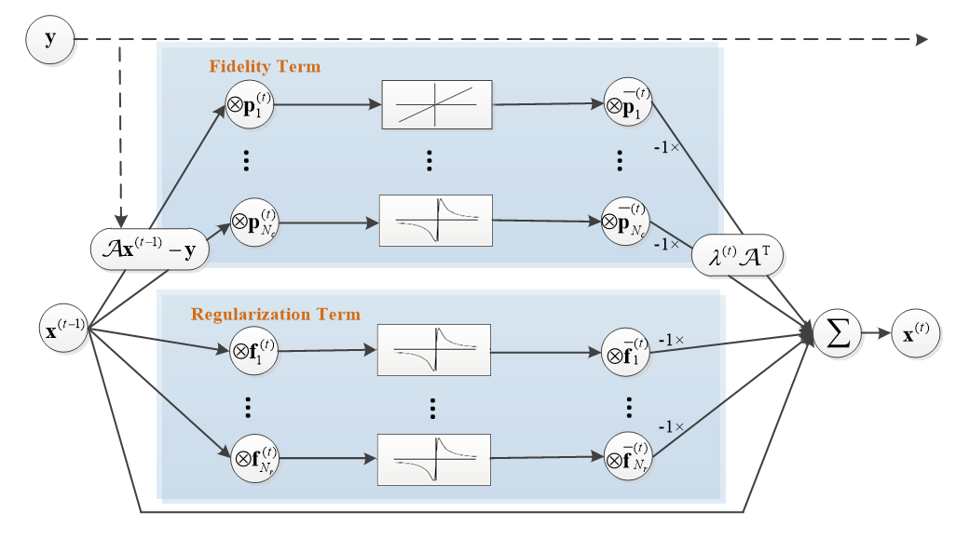
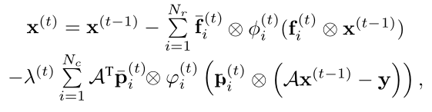


SFARL
Gradient descent optimization
Model parameters
Fidelity
Regularization

Slide 31
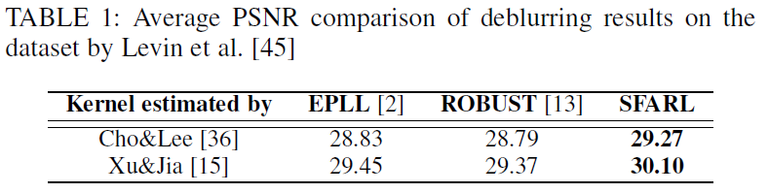
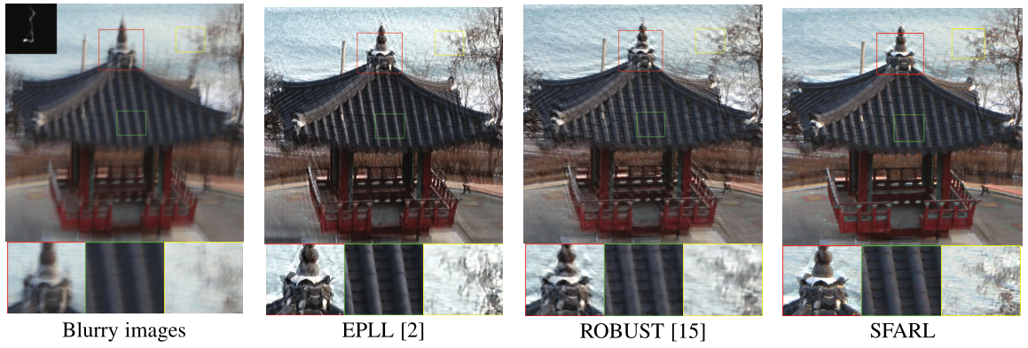
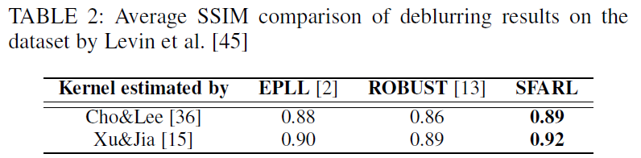
Results

Slide 32
Outline
Background
Discriminative Learning of Iteration-wise Priors for Blur Kernel Estimation
Learning Robust Non-Blind Deconvolution Models
Self-Learning for Blind Deconvolution

Slide 33
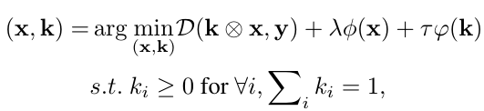
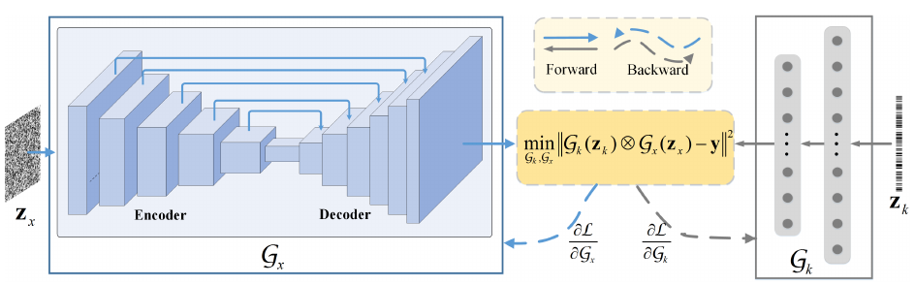
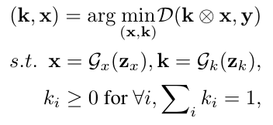
SelfDeblur
SoftMax Layer
Self-Learning to Optimize Blind Deconvolution, Submitted.

Slide 34
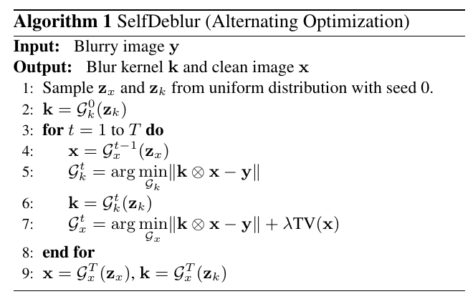
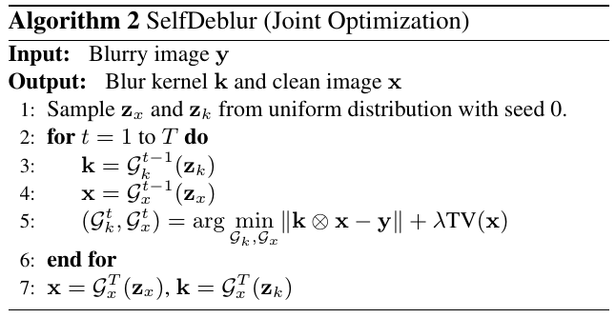

Slide 35
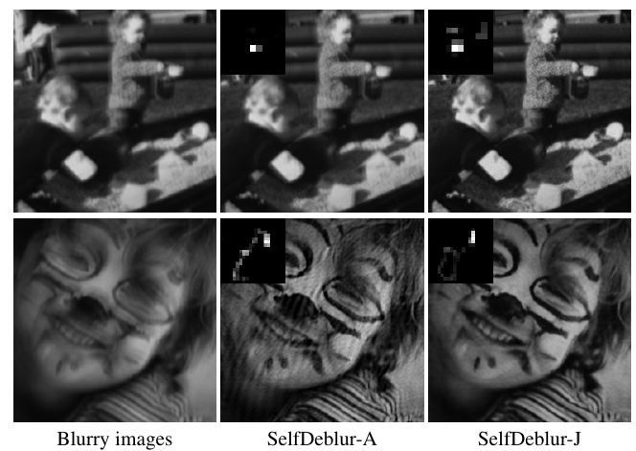
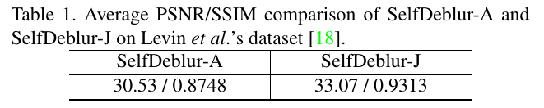
Alternating vs. Joint Optimization

Slide 36
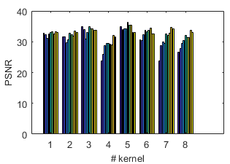
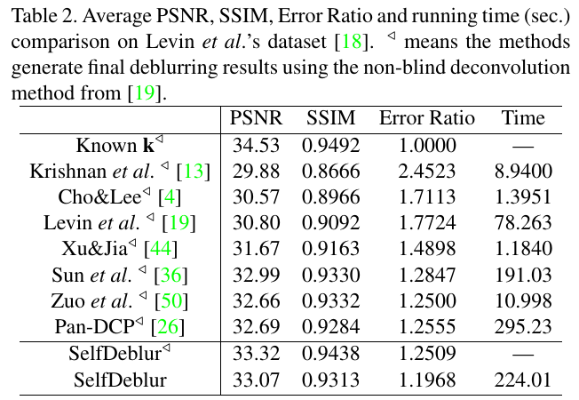
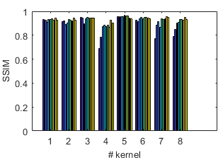

Results

Slide 37
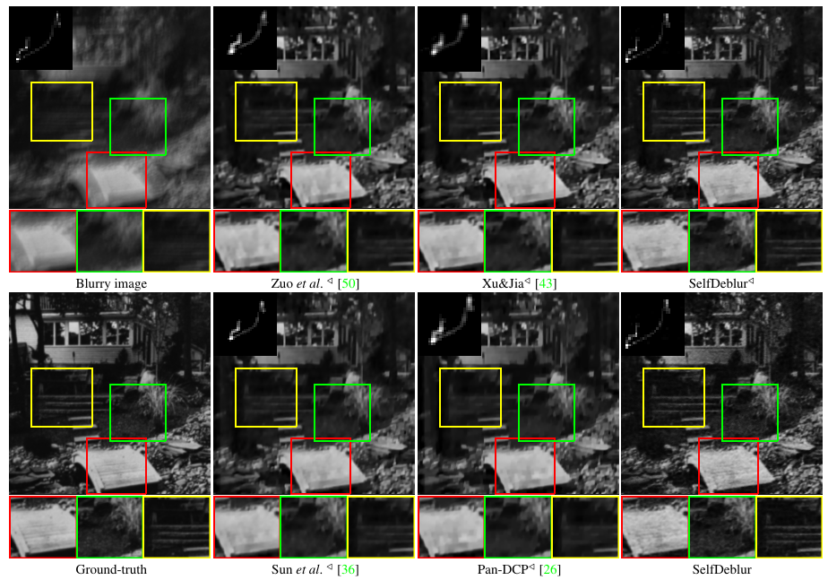

Slide 38
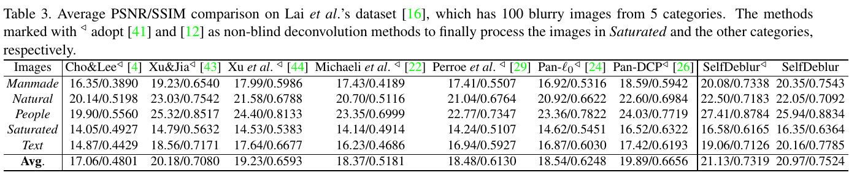


Results

Slide 39


Slide 40
Summary
Learning iteration-wise image priors lead to efficient and robust blur kernel estimation.
Learning non-blind deconvolution models contribute to relieve blur kernel estimation error and restore visually favorable results.
Self-learning generative priors succeed in both estimating blur kernels and restoring clean images.

Slide 41
Thanks~
Homepage of Prof. Zuo http://homepage.hit.edu.cn/wangmengzuo
Homepage of Dongwei Ren https://csdwren.github.io

