Slide 1
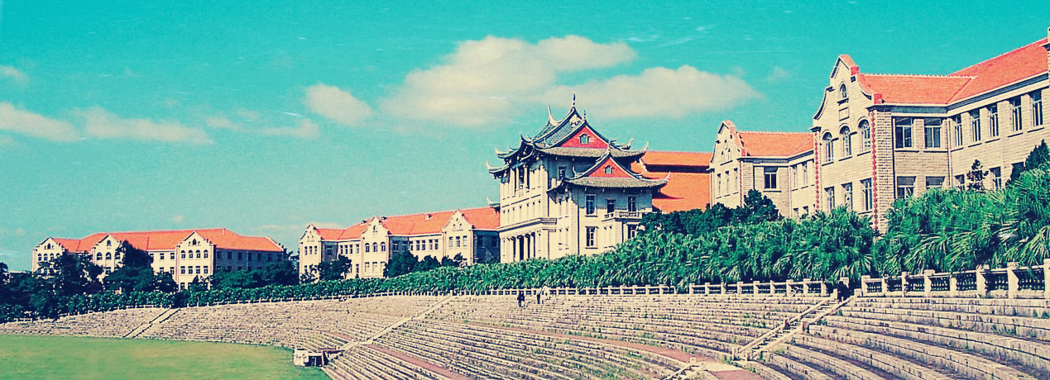
视觉大数据系统紧凑性初探
--视觉特征紧凑表示与深度网络压缩
纪荣嵘（厦门大学）
媒体分析与计算实验室
mac.xmu.edu.cn
2017年09月24日于南昌

Slide 2
纪荣嵘 厦门大学
教育背景
研究兴趣
视觉特征的紧凑性：紧凑视觉特征描述子及其相关MPEG国际标准、视觉词包向量压缩与量化优化、面向视觉搜索的大规模特征哈希
机器学习模型优化：大规模并行化测度学习、深度神经网络模型压缩、大规模跨模态分类模型、大规模弱监督学习模型
社交网络分析：跨媒体话题建模与热度监控、话题社交子网络分割、跨媒体舆情分析、人群情绪跨空间表达
2005-2011：哈尔滨工业大学，计算机科学与技术专业，硕博连读
工作经历
2010-2013：美国哥伦比亚大学，数字视频与多媒体实验室，博士后研究员
目前任职
目前：厦门大学，福建省“闽江学者”特聘教授，博士生导师，媒体分析与计算实验室负责人（PI）

Slide 3


Slide 4
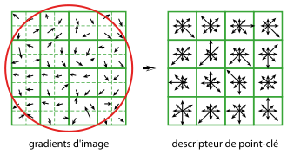
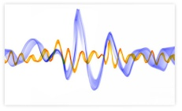
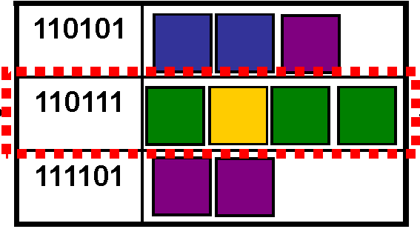
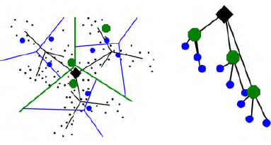
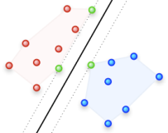

研究动机
视觉大数据搜索与识别系统
  特征抽取
    变换不变性、速度
  特征描述
    判决力、鲁棒性、存储（内存与数据库开销）
  特征索引
    速度（倒排索引等技术） 、近似紧邻的逼近能力
    紧凑性问题
  分类识别
    嵌入式系统、硬件实现
    精度、速度、存储、耗电量、无线传输开销
紧凑性问题

Slide 5
报告提纲
面向大规模视觉搜索的特征哈希
  概念介绍
  相关进展
  工作汇报
深度神经网络压缩
  概念介绍
  常用模型
  工作汇报
  总结与展望

Slide 6
报告提纲
面向大规模视觉搜索的特征哈希
  概念介绍
  相关进展
  工作汇报
深度神经网络压缩
  概念介绍
  常用模型
  工作汇报
  总结与展望

Slide 7
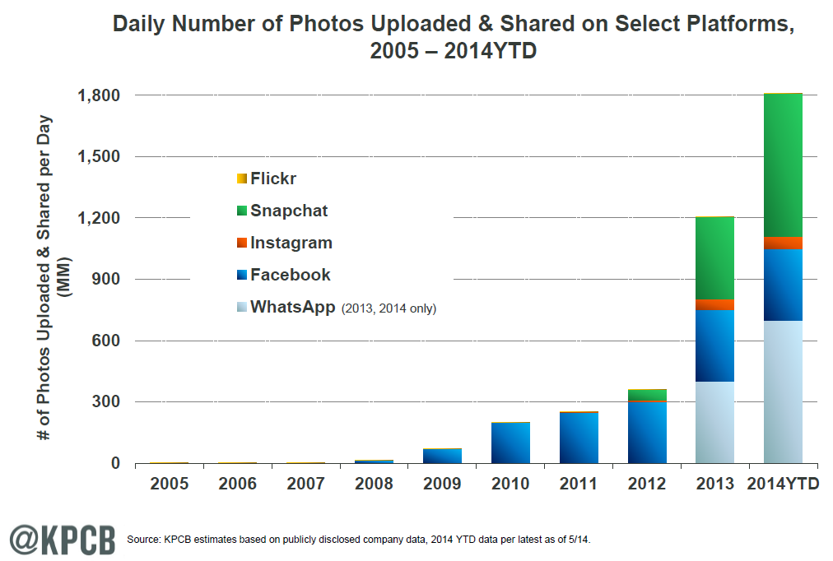
面向大规模视觉搜索的特征哈希
概念介绍
  视觉数据近年来的爆炸性增长

Slide 8
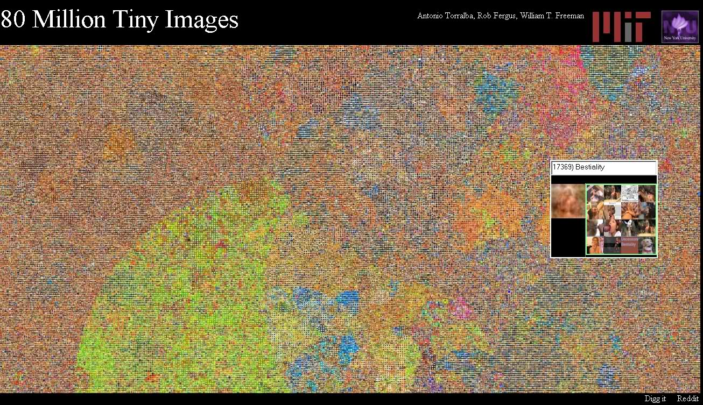
面向大规模视觉搜索的特征哈希
概念介绍
  大规模视觉搜索技术的紧迫需求
    实际应用问题经常面临百千万/亿级视觉（图片、视频）数据库

Slide 9
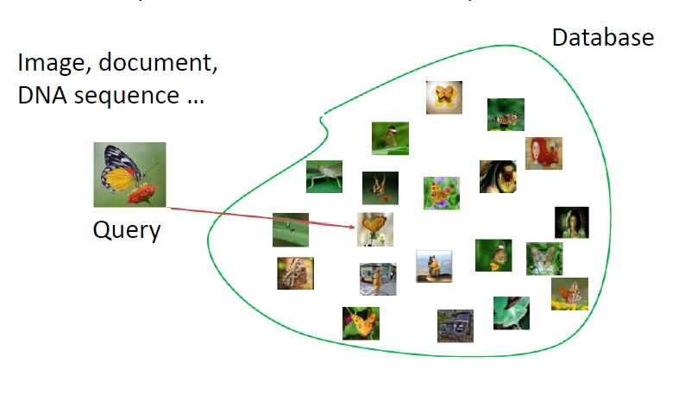
面向大规模视觉搜索的特征哈希
概念介绍
  大规模视觉搜索技术的紧迫需求
    计算资源限制->有限的内存容量与时间效率容忍性
      常用解决方案：近似近邻搜索（ANN）

Slide 10
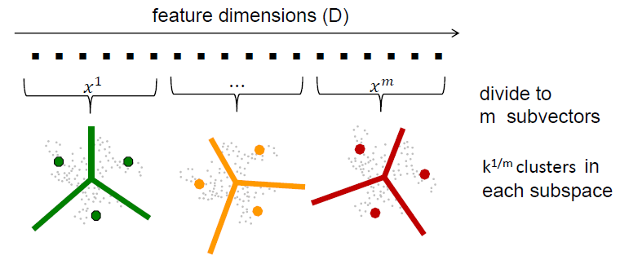
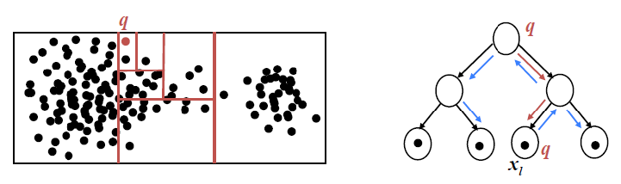
面向大规模视觉搜索的特征哈希
概念介绍
  大规模视觉搜索技术的紧迫需求
    传统的视觉特征表示维度过高
      视觉词包特征，CNN特征, VLAD特征, Fisher向量特征…
    倒排索引表内容开销过大
      倒排表：空间换时间
    移动与嵌入式系统的场景限制
      无法容忍高维实值特征的时空开销
      最小化数据通信量的需求
例子1：K-D树
例子2：乘法量化

Slide 11
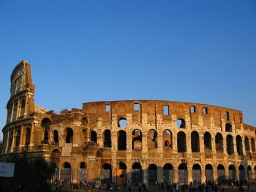
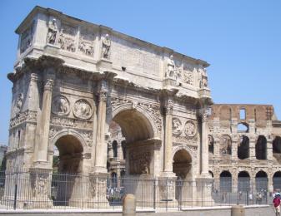
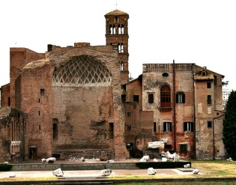
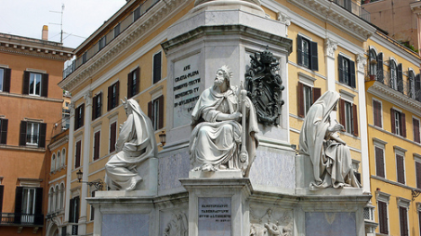
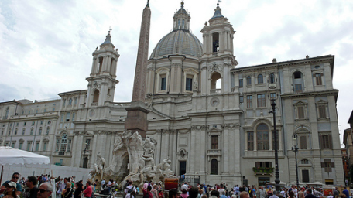
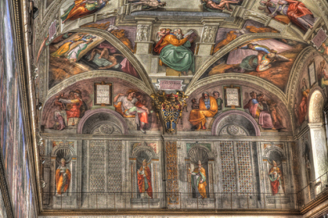
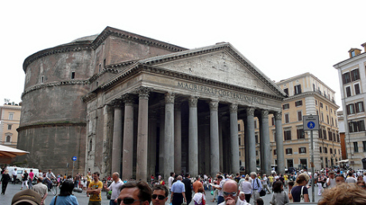
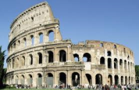
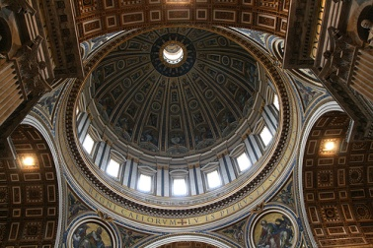
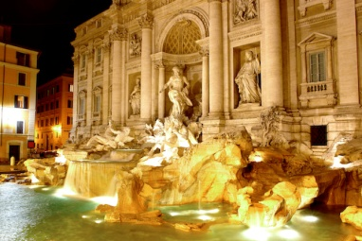

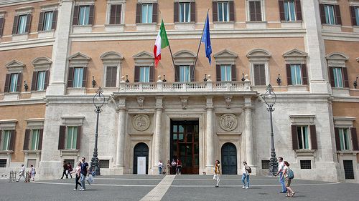
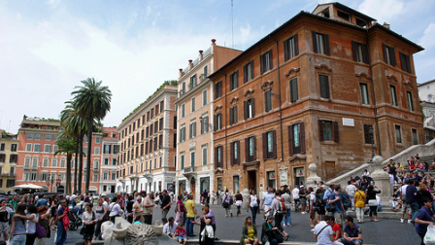
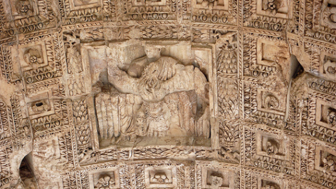
面向大规模视觉搜索的特征哈希
概念介绍
  面向大规模视觉搜索的特征哈希（原理）
    特征二值化（局部保值、逼近原始相似度）
      二值特征的汉明距离->特征的相似性（Locality Sensitive）
      汉明距离可逼近原始的欧式距离
1011001011…0101
1110101101…0010
0001111000…1010
1111111001…0001
1010101010…1001
0001111110…1010
0101101001…1111
1001111000…1010
0001001001…0010
1001110010…1010
1101111000…0010
Binary coding

Slide 12

面向大规模视觉搜索的特征哈希
概念介绍
  面向大规模视觉搜索的特征哈希（原理）
    特征二值化（局部保值、逼近原始相似度）
      二值特征的汉明距离->特征的相似性（Locality Sensitive）
      汉明距离可逼近原始的欧式距离
1011001011…0101
1110101101…0010
0001111000…1010
1111111001…0001
1010101010…1001
0001111110…1010
0101101001…1111
1001111000…1010
0001001001…0010
1001110010…1010
1101111000…0010
1101111001…0001
Similar images
||x – y|| ≈ 0
Binary coding

Slide 13
面向大规模视觉搜索的特征哈希
概念介绍
  面向大规模视觉搜索的特征哈希（原理）
    特征二值化（局部保值、逼近原始相似度）
      二值特征的汉明距离->特征的相似性（Locality Sensitive）
      汉明距离可逼近原始的欧式距离
1011001011…0101
1110101101…0010
0001111000…1010
1111111001…0001
1010101010…1001
0001111110…1010
0101101001…1111
1001111000…1010
0001001001…0010
1001110010…1010
1101111000…0010
1010011011…1111
Dissimilar images
||x – y|| is large
Binary coding

Slide 14
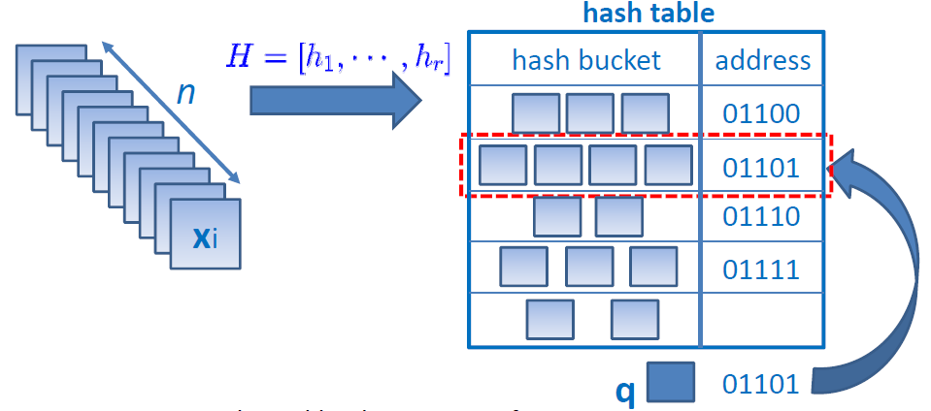
面向大规模视觉搜索的特征哈希
概念介绍
  面向大规模视觉搜索的特征哈希（优势）
    哈希函数为特征投影->快
    搜索时间为汉明查表，复杂度O(1) ->快
    百万量级图像搜索系统可以存储在内存中 -> 小

Slide 15
面向大规模视觉搜索的特征哈希
概念介绍
  代表性的特征哈希技术
    数据独立哈希
        Local Sensitive Hashing (Indyk and Motwani 1998, Datar et al. 2004)…
    数据非独立哈希
      无监督哈希
        Spectral Hashing (Weiss et al. NIPS 2008)
        Anchor Graph Hashing (Liu et al. ICML 2011)
        Iterative Quantization (Gong et al. CVPR 2011)
        Discrete Graph Hashing (Liu et al. NIPS 2014)
        Scalable Graph Hashing (Jiang et al. IJCAI 2015)
        Ranking Preserved Hashing (Song et al. DCC 2015)
        Top Rank Supervised Binary Coding (Song et al. ICCV 2015)
        Ordinal Embedding Hashing (Liu et al. AAAI 2016)…
      有监督哈希
        Kernel Supervised Hashing (Liu et al. CVPR 2012)
        Supervised Discrete Hashing (Shen et al. CVPR 2014)…
Our work

Slide 16
面向大规模视觉搜索的特征哈希
概念介绍
  Locality Sensitive Hashing (Indyk, Motawani 1998)
    Hash family H on (X,D) is (r,εr,P1,P2)-sensitive, if for q,p ∈X:
      if D(p,q) ≤ r, then Pr[h(p)=h(q)]≥P1
      if D(p,q) ≥ εr, then Pr[h(p)=h(q)]≤P2
      Can solve ANN with roughly and query time
Q
Database
Quality
3
2
1

Slide 17
报告提纲
面向大规模视觉搜索的特征哈希
  概念介绍
  相关进展
  工作汇报
深度神经网络压缩
  概念介绍
  常用模型
  工作汇报
  总结与展望

Slide 18

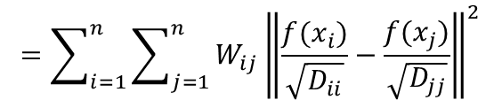
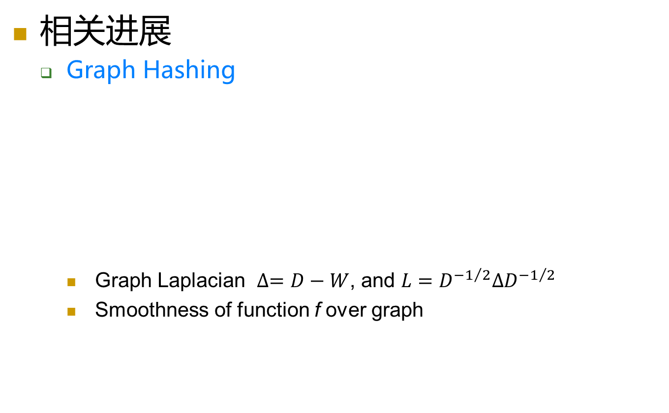





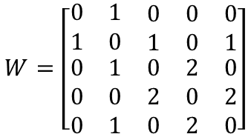
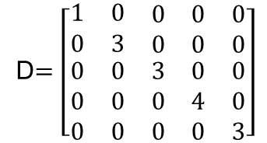
面向大规模视觉搜索的特征哈希
相关进展
  Graph Hashing
    Graph Laplacian $∆=D−W$, and $L=D^{−1/2}∆D^{−1/2}$
    Smoothness of function f over graph
$$x_{1}$$
1
$$x_{2}$$
Affinity matrix
Degree matrix
1
$$W=\left[\begin{matrix}0 & 1 & \begin{matrix}0 & 0 & 0\end{matrix} \\ 1 & 0 & \begin{matrix}1 & 0 & 1\end{matrix} \\ \begin{matrix}0 \\ 0 \\ 0\end{matrix} & \begin{matrix}1 \\ 0 \\ 1\end{matrix} & \begin{matrix}\begin{matrix}0 & 2 & 0\end{matrix} \\ \begin{matrix}2 & 0 & 2\end{matrix} \\ \begin{matrix}0 & 2 & 0\end{matrix}\end{matrix}\end{matrix}\right]$$
D$=\left[\begin{matrix}1 & 0 & \begin{matrix}0 & 0 & 0\end{matrix} \\ 0 & 3 & \begin{matrix}0 & 0 & 0\end{matrix} \\ \begin{matrix}0 \\ 0 \\ 0\end{matrix} & \begin{matrix}0 \\ 0 \\ 0\end{matrix} & \begin{matrix}\begin{matrix}3 & 0 & 0\end{matrix} \\ \begin{matrix}0 & 4 & 0\end{matrix} \\ \begin{matrix}0 & 0 & 3\end{matrix}\end{matrix}\end{matrix}\right]$
1
$$x_{3}$$
$$x_{5}$$
2
2
$$x_{4}$$
$$<f,Lf>=f^{T}Lf$$
$$=\sum_{i=1}^{n}{\sum_{j=1}^{n}{W_{ij}{\left\|\frac{f(x_{i})}{\sqrt{D_{ii}}}−\frac{f(x_{j})}{\sqrt{D_{jj}}}\right\|}^{2}}}$$

Slide 19

面向大规模视觉搜索的特征哈希
相关进展
  Graph Hashing
    Eigenvectors of Laplacian L given smooth functions over points
    Can be used to discover structures approximately
$$<h,Lh>=h^{T}Lh=\frac{1}{2}\sum_{i=1}^{n}{\sum_{j=1}^{n}{W_{ij}{\left\|h\left(x_{i}\right)−h(x_{j})\right\|}^{2}}}$$
      When the size of graph is large (million or billion)
        Hard to construct graph
        Hard to compute the neighbors

Slide 20
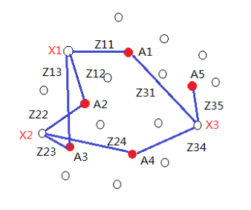






面向大规模视觉搜索的特征哈希
相关进展
  Anchor Graph Hashing (Liu et al. ICML 2011)
    Use anchor points to approximate the graph structure
    Compute data-to-anchor similarity: Sparse local embedding
    Appro. data-to-data similarity W: Inner product in low rank space
Random sampling or K-means clustering
$$Z∈R^{n×m}, m ≪n$$
$$W_{ij}=\sum_{k=1}^{m}{Z_{ik}Z_{jk}}=Z_{i}Z_{j}^{T}$$
Anchor points
$$x_{1}:Z_{1}=\{Z11,Z12,Z13,0,0\}$$
$$x_{2}:Z_{2}=\{0,Z22,Z23,0,Z24\}$$
$$x_{3}:Z_{3}=\{Z31,0,0,Z34,Z35\}$$
$$Z_{1}∙Z_{2}>Z_{1}∙Z_{3}$$

Slide 21
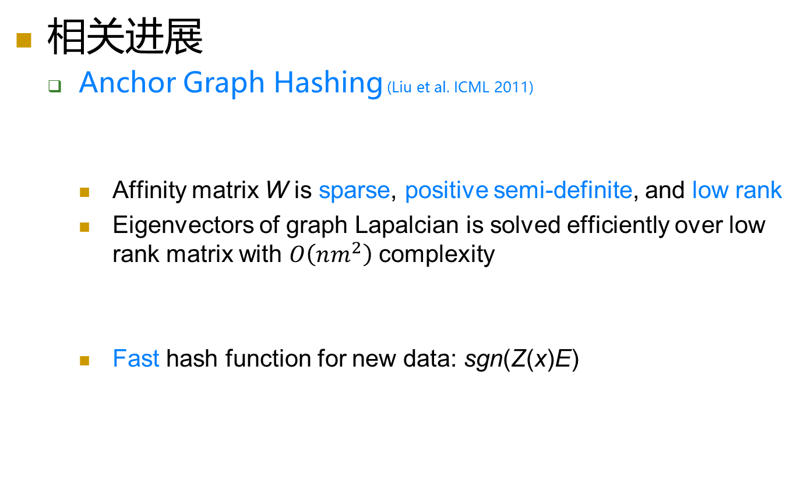

面向大规模视觉搜索的特征哈希
相关进展
  Anchor Graph Hashing (Liu et al. ICML 2011)
    Affinity matrix W is sparse, positive semi-definite, and low rank
    Eigenvectors of graph Lapalcian is solved efficiently over low rank matrix with $O\left(nm^{2}\right)$ complexity
    Fast hash function for new data: sgn(Z(x)E)
$$W=ZΛ^{−1}Z^{T},where Λ=diag(1^{T}Z)$$
$$E=\{e_{1},…,e_{K}\}∈R^{m×K}$$

Slide 22
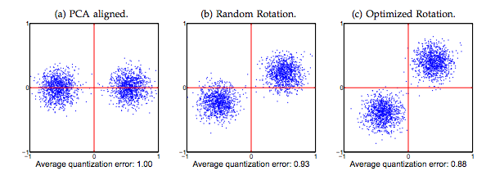


面向大规模视觉搜索的特征哈希
相关进展
  Iterative Quantization (Gong et al. PAMI 2013)
    Firstly, find the projection matrix W by PCA
    Secondly, find orthogonal rotation matrix R to minimize quan. loss:
$$Q\left(B,R\right)={\left\|B−VR\right\|}_{F}^{2}$$
$$={\left\|B\right\|}_{F}^{2}+{\left\|V\right\|}_{F}^{2}−2tr(BR^{T}V^{T})$$
$$=nc+{\left\|V\right\|}_{F}^{2}−2tr(BR^{T}V^{T})$$
Fixed items

Slide 23


面向大规模视觉搜索的特征哈希
相关进展
  Iterative Quantization (Gong et al. PAMI 2013)
    Start with R being a random orthogonal matrix
    Minimize the quantization loss by alternating steps:
      Fix R and update B:
      Fix B and update R:
    Easy to apply to supervised methods
$$B=sgn(VR)$$
Classic orthogonal pursuit problem, for fixed B solution
Compute SVD of $B^{T}V$ as $SΩ{\hat{S}}^{T}$ and set $R=\hat{S}S$
PCA
CCA

Slide 24
面向大规模视觉搜索的特征哈希
相关进展
  Supervised Hashing with Kernels (Liu et al. CVPR 12)
    Hashing quality is boosted by leveraging supervised information: similar and dissimilar pairs
dissimilar
x_{i},x_{j} are similar →h(x_{i}) = h(x_{j})
x_{i},x_{j} are dissimilar →h(x_{i}) ≠ h(x_{j})
similar
1
0
h(x)→desirable hash function
Liu, Jiang, Ji, Supervised Hashing with Kernels, IEEE CVPR 2012, Oral Presentation

Slide 25
面向大规模视觉搜索的特征哈希
相关进展
  Supervised Hashing with Kernels (Liu et al. CVPR 12)
    Hamming distance can be computed by inner product
Coding Inner Product
Hamming Distance
Liu, Jiang, Ji, Supervised Hashing with Kernels, IEEE CVPR 2012, Oral Presentation

Slide 26
报告提纲
面向大规模视觉搜索的特征哈希
  概念介绍
  相关进展
  工作汇报
深度神经网络压缩
  概念介绍
  常用模型
  工作汇报
  总结与展望

Slide 27











面向大规模视觉搜索的特征哈希
工作汇报
  Top Rank Supervised Binary Coding (Song et al. ICCV 2015)
    Traditional hashing: Pairwise similarity
    How about ranking-based relative similarity?
      Ranking based hashing
        Column generation hashing
        Ranking supervised hashing
        …
$$x_{2}$$
Ranking list
Hamming Ranking List
Hash Function
$$x_{4}$$
x₁ | 1
x₂ | 3
x₃ | 2
x₄ | 4
$$π(x_{1})$$
$$x_{3}$$
1100…1
$$π(x_{2})$$
$$x_{1}$$
1100…1
$$π(x_{3})$$
$$x_{2}$$
1110…1
q
Minimizing ranking error
$$x_{3}$$
0100…1
$$x_{1}$$
$$π(x_{4})$$
$$x_{4}$$
1111…1

Slide 28
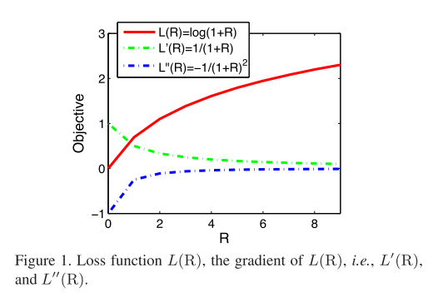
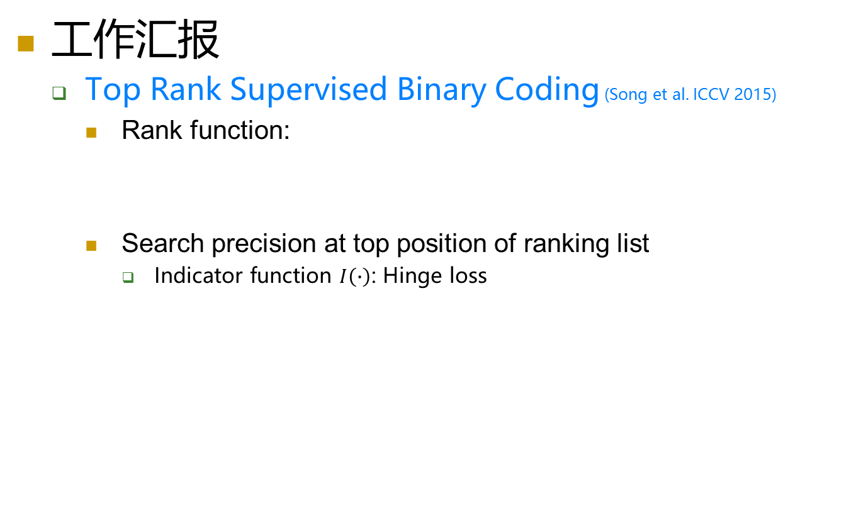
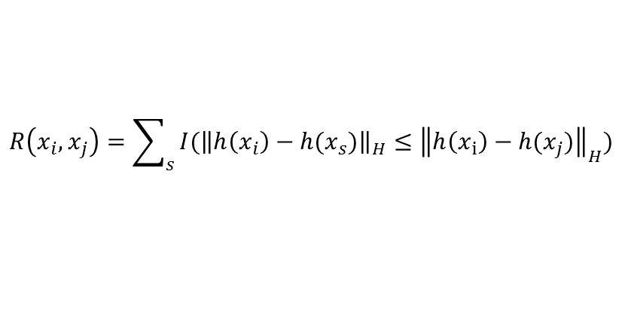




面向大规模视觉搜索的特征哈希
工作汇报
  Top Rank Supervised Binary Coding (Song et al. ICCV 2015)
    Rank function:
    Search precision at top position of ranking list
      Indicator function $I\left(∙\right)$: Hinge loss
Triplet ranking
$$R\left(x_{i},x_{j}\right)=\sum_{s}{I({\left\|h\left(x_{i}\right)−h(x_{s})\right\|}_{H}≤{\left\|h\left(x_{i}\right)−h(x_{j})\right\|}_{H})}$$
$$x_{s}$$
$$x_{j}$$
A ranking loss function used here
$$x_{i}$$
$$L\left(R\left(x_{i},x_{j}\right)\right)=log⁡(1+R\left(x_{i},x_{j}\right))$$

Slide 29

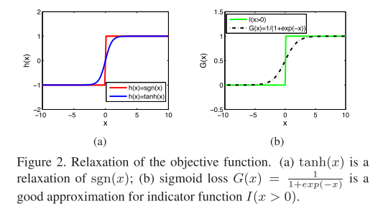
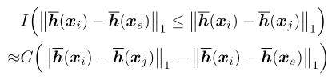

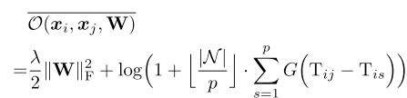


面向大规模视觉搜索的特征哈希
工作汇报
  Top Rank Supervised Binary Coding (Song et al. ICCV 2015)
    The ranking-based loss function:
    Two relaxations for efficient optimization:
    The final objective function:
Relax Indicator function $I(∙)$
Hash function H$(∙)$

Slide 30
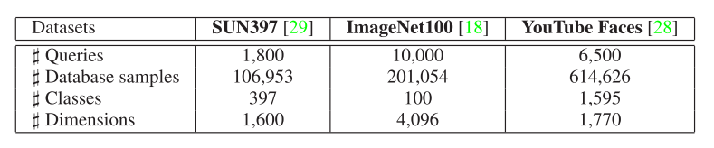
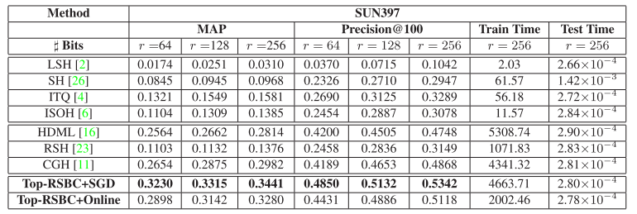
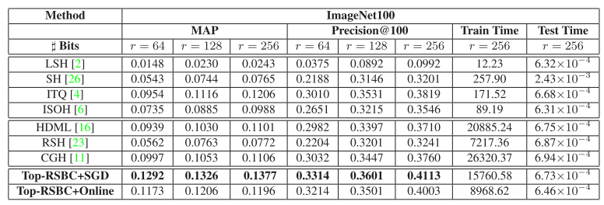
面向大规模视觉搜索的特征哈希
工作汇报
  Top Rank Supervised Binary Coding (Song et al. ICCV 2015)
    Quantitative Results on Sun and ImageNet100

Slide 31
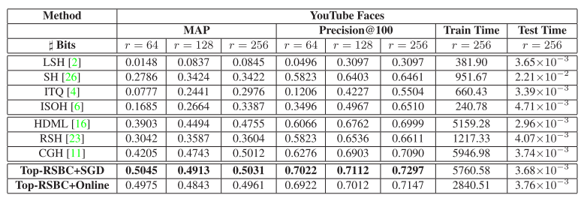
面向大规模视觉搜索的特征哈希
工作汇报
  Top Rank Supervised Binary Coding (Song et al. ICCV 2015)
    Quantitative Results on YouTubeFace

Slide 32
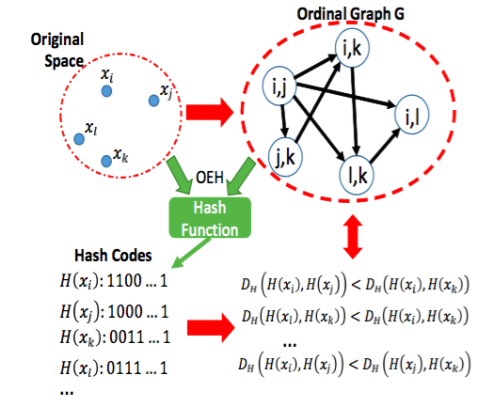
面向大规模视觉搜索的特征哈希
工作汇报
  Ordinary Embedding Hashing (Liu et al. AAAI 2016)
    Unsupervised hashing with ranking info.
      Previous work: Pairwise similarity or rank list
      Ordinal info. (relative order, rather than the Euclidean distance) is indeed more important

Slide 33


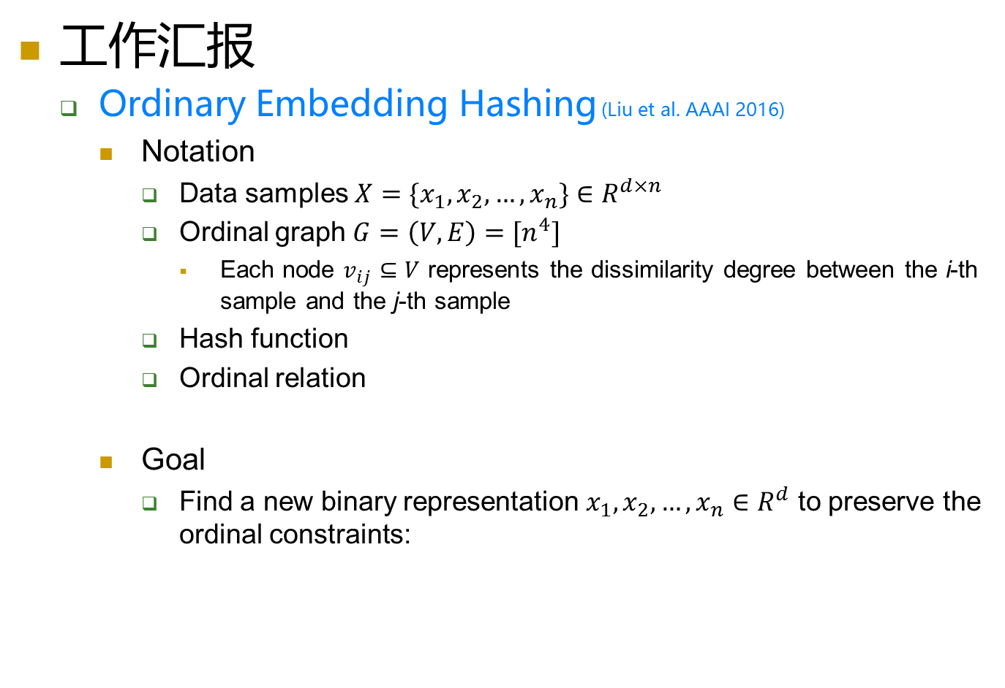
面向大规模视觉搜索的特征哈希
工作汇报
  Ordinary Embedding Hashing (Liu et al. AAAI 2016)
    Notation
      Data samples $X=\{x_{1},x_{2},…,x_{n}\}∈R^{d×n}$
      Ordinal graph $G=\left(V,E\right)=[n^{4}]$
        Each node $v_{ij}⊆V$ represents the dissimilarity degree between the i-th sample and the j-th sample
      Hash function
      Ordinal relation
    Goal
      Find a new binary representation $x_{1},x_{2},…,x_{n}∈R^{d}$ to preserve the ordinal constraints:

Slide 34
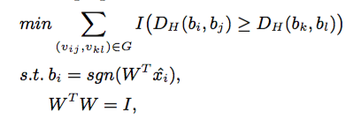

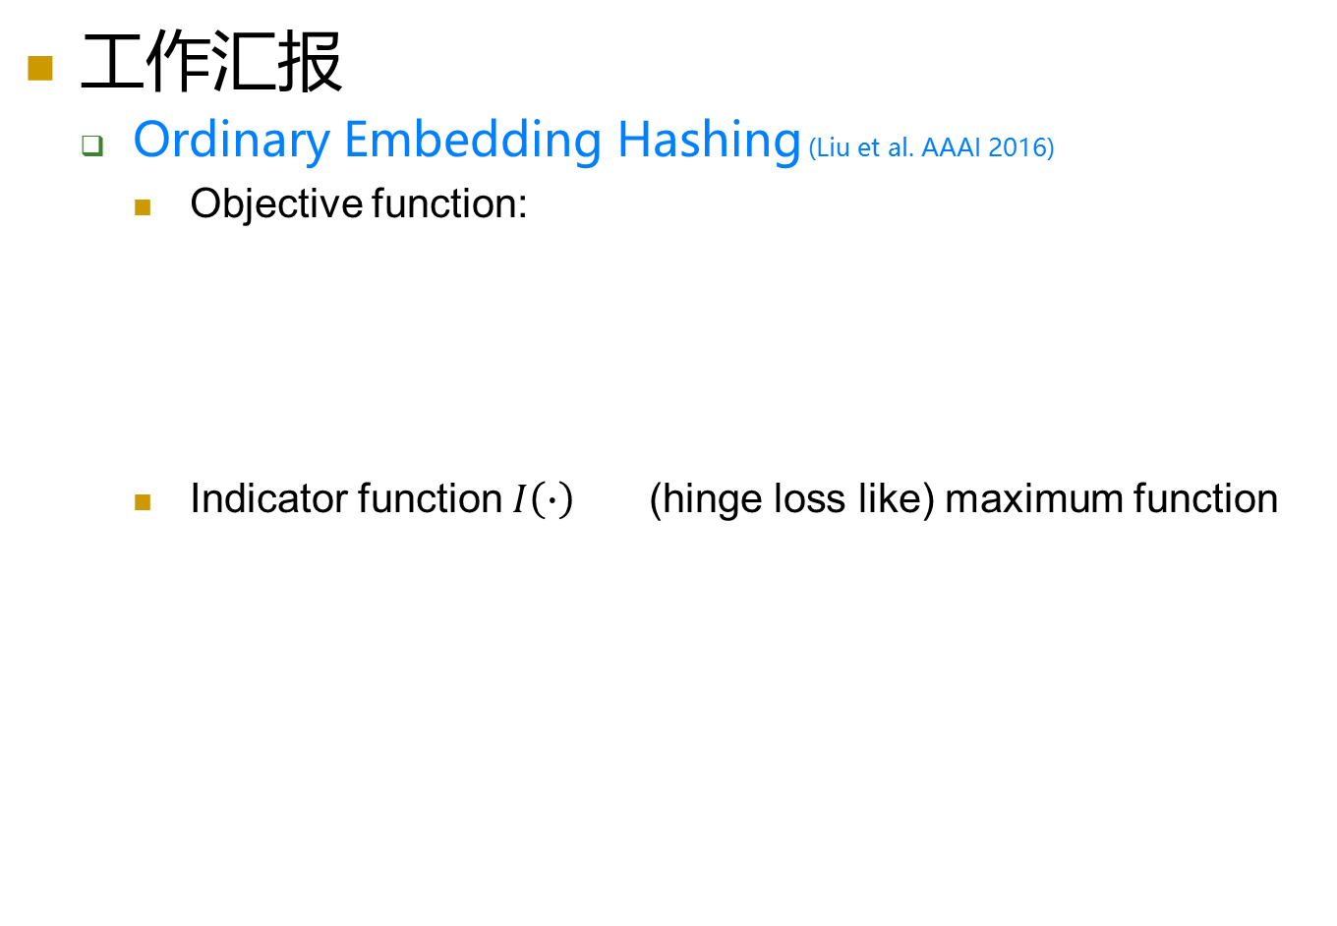


面向大规模视觉搜索的特征哈希
工作汇报
  Ordinary Embedding Hashing (Liu et al. AAAI 2016)
    Objective function:
    Indicator function $I\left(∙\right)$ (hinge loss like) maximum function
$$o\left(v_{ij},v_{kl}\right)=\left\{\begin{matrix}1, \\ 0,\end{matrix}\right.$$
when a directed edge from $v_{ij}$ to $v_{kl}$
otherwise

Slide 35

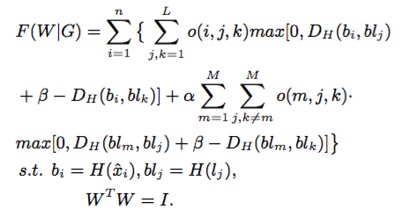
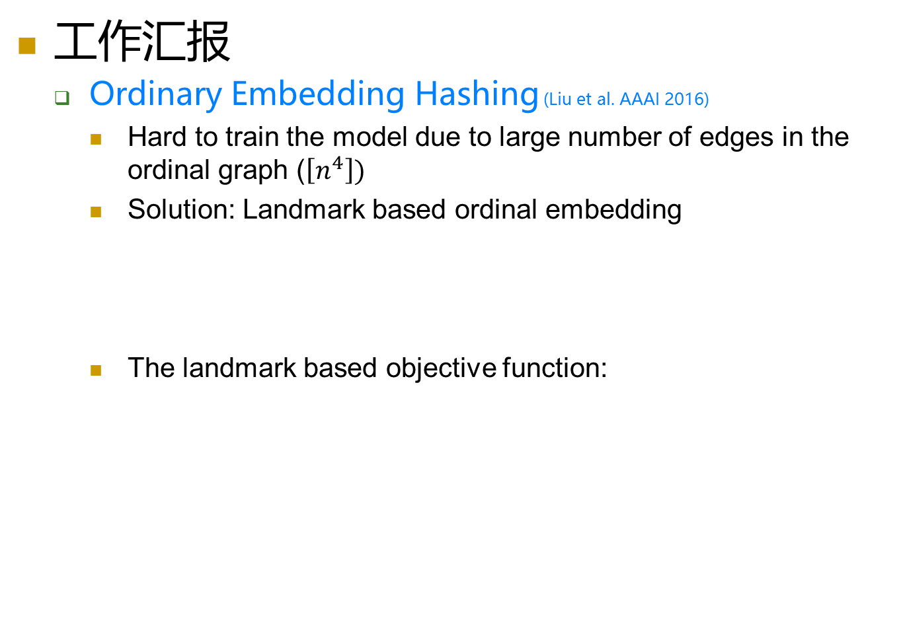

面向大规模视觉搜索的特征哈希
工作汇报
  Ordinary Embedding Hashing (Liu et al. AAAI 2016)
    Hard to train the model due to large number of edges in the ordinal graph ($\left[n^{4}\right])$
    Solution: Landmark based ordinal embedding
    The landmark based objective function:
$$[L∙n^{2}]$$

Slide 36


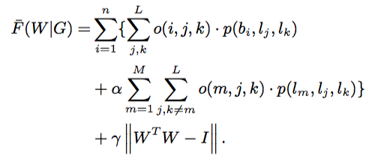

面向大规模视觉搜索的特征哈希
工作汇报
  Ordinary Embedding Hashing (Liu et al. AAAI 2016)
    Relaxation:
      Hash function
      Maximum function
      Hamming Distance
    The relaxed objective function
$$\overline{H}\left({\hat{x}}_{i}\right)=tanh⁡(W^{T}{\hat{x}}_{i})$$
Learn by Stochastic Gradient Descent

Slide 37
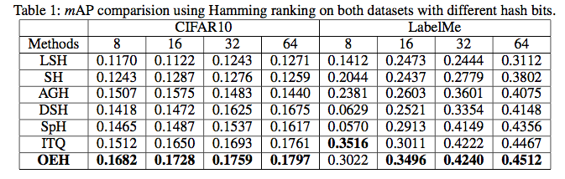

面向大规模视觉搜索的特征哈希
工作汇报
  Ordinary Embedding Hashing (Liu et al. AAAI 2016)
    CIFAR10 and LabelMe
      512-D GIST feature
      1,000 query and 59,000 training data in CIFAR10
      2,000 query and 20,019 training data in LabelMe
    MIR-QBSH
      48 music midi and 2000 noisy midi
      4431 humming query
      MIREX 2015 Top 1st

Slide 38


面向大规模视觉搜索的特征哈希
工作汇报
  Ordinary Embedding Hashing (Liu et al. AAAI 2016)
    落地应用： QQ音乐哼唱搜索
2016年1月至今，1.47亿用户哼唱使用量

Slide 39
报告提纲
面向大规模视觉搜索的特征哈希
  概念介绍
  相关进展
  工作汇报
深度神经网络压缩
  概念介绍
  常用模型
  工作汇报
  总结与展望

Slide 40





深度神经网络在视觉中的应用
CNNs have achieved successes in various areas of CV
…
Image retrieval
Image classification
Object detection
Object tracking
Edge detection

Slide 41
深度神经网络在视觉中的应用
ImageNet Classification with Deep Convolutional Neural Networks, NIPS 2012
Spatial Pyramid Pooling in Deep Convolutional Networks for Visual Recognition, ECCV 2014
Very Deep Convolutional Network for Large-scale Image Recognition, ICLR 2015
Going Deeper With Convolutions, CVPR 2015
Where to Buy It: Matching Street Clothing Photos in Online Shops, ICCV 2015
Deep Learning for Content-Based Image Retrieval: A Comprehensive Study, ACMMM, 2014
DeepContour: A Deep Convolutional Feature Learned by Positive-Sharing Loss for Contour Detection Draft Version, CVPR 2015
DeepEdge: A Multiscale Bifurcated Deep Network for Top-down Contour Detection, CVPR 2015
Holistically-Nested Edge Detection, ICCV 2015
Rich feature hierarchies for accurate object detection and semantic segmentation, CVPR 2014
Is Object Localization for Free-Weakly-supervised Learning with Convolutional Neural Networks, CVPR 2015
Scalable Object Detection using Deep Neural Networks, CVPR 2014
Transferring Rich Feature Hierarchies for Robust Visual Tracking, ArXiv 2015
Deep Convolutional Network Cascade for Facial Point Detection, CVPR 2013
Facial Landmark Detection by Deep Multi-task Learning, ECCV 2014
Coarse-to-Fine Auto-encoder Networks (CFAN) for Real-time Face Alignment, ECCV 2014
Modeling Inter- and Intra-Part Deformations for Object Structure Parsing, IJCAI 2015

Slide 42



常用的深度神经网络
2012年ILSVRC冠军
    AlexNet (Alex Krizhevsky 2012)
      ReLu Nonlinearity
      Local response normalization
      Data augmentation and dropout
Result
Notes:
AlexNet: Large Scale Visual Recognition Challenge 2012 (ILSVRC2012)冠军，该模型为后续视觉方向各种应用奠定坚实的基础。
AlexNet引入了很多技巧加速训练和提高分类精度，如：
引入ReLU非线性激活函数
LRN
两个GPU加速训练
防止过拟合引入两个trick：扩大样本数和Dropout

Slide 43


常用的深度神经网络
目标检测中的深度神经网络
    SPPNet
Notes:
Motivation:
Why do CNNs require a fixed input size ?
1.sliding-window manner
2. output feature maps which represent the spatial arrangement of the activations
Convolutional layers do not require a fixed image size and can generate feature maps of any sizes
Fully-connected layers need to have fixed-size/length input by their definition.

Slide 44

常用的深度神经网络
http://www.robots.ox.ac.uk/~vgg/research/very_deep/
更深？
    VGGNet、Residual Net
Notes:
The architecture of VGG
16-layers VGG
19-layers VGG

Slide 45

常用的深度神经网络
模型构造的修正
    GoogleNet
      Increasing the size of CNN (depth and width)
        Overfitting
        Increase use of computational resources
      Inception module
        Sparsely connected architectures (or convolutions)
Inception module with dimension reductions
Notes:
传统意义上，要想提高深度网络的性能必须通过增加网络的深度和每层的节点个数，但会产生overfitting和增加计算量
因此GoogLeNet提出了一种新的想法（Inception Module）它将每层网络都进行稀疏连接，从而提高网络的性能。
GoogLeNet拥有22层，但最后的训练好的model memory只有51M。

Slide 46
如何压缩网络模型？

Slide 47

Compressing Deep Convolutional Networks Using Vector Quantization (Arxiv 2014)
Binary Quantization
    Given the parameter W, take the sign of matrix:
    More aggressive than Dropout
    Turn each neuron on if it is positive and off when it is negative
    Compression rate is 32

Slide 48


Compressing Deep Convolutional Networks Using Vector Quantization (Arxiv 2014)
Scalar Quantization
    Given the parameter , transform to its scalar values as , perform k-means clustering
    Each value in w is assigned a cluster index
      Form a codebook
    Look up the values for each in c, the reconstructed matrix is:
    Compression rate is

Slide 49



Compressing Deep Convolutional Networks Using Vector Quantization (Arxiv 2014)
Product Quantization
    Given the parameter W, partition it into submatrices:
    , perform k-means clustering to each
    The reconstructed matrix is:
    Compression rate is

Slide 50


Compressing Deep Convolutional Networks Using Vector Quantization (Arxiv 2014)
Residual Quantization
    Given the parameter , transform to its scalar values as , and quantize into k different vectors:
    Compute the residual between and , and recursively quantize the residual vector into k different words
    The reconstructed vector is :
    Compression rate is

Slide 51

Compressing Deep Convolutional Networks Using Vector Quantization (Arxiv 2014)
Results
Notes:
此张ppt描述ANALYSIS OF PRODUCT QUANTIZATION
using more centers k and smaller segment size s can obtain smaller classification error. see red curve. (32mn/(32kn + log2(k)ms))
Consider codebook and the accuracy for the same compression rate, using more centers is not always helpful, because they can increase
the codebook size.
3. we compare the results of compressing the x-axis and y-axis, the results for the x-axis are slightly better. because there
are more dimensions for the x-axis, which makes the codebook size larger and thereby reduces the loss of information.

Slide 52

Compressing Deep Convolutional Networks Using Vector Quantization (Arxiv 2014)
Results
t=2,3
Notes:
此张ppt描述各个baseline总体性能的比较
SVD does not work well for compressing dense connected layers, because the two factorized matrices still need to be stored for SVD.
2. Kmeans: achieve a 4-8 times compression rate with KM while keeping the accuracy loss within 1%.
3. PQ can further improve performance beyond our results for KM
4. RQ was not able to achieve a very high compression rate, mainly because the codebook size was too big.
5. Binary method was not able to vary its compression rate, but given the same compression rate its performance was comparable to KM or PQ
6. These results suggests that there is considerable redundancy between each single neuron (KM can achieve a descent compression without sacrificing
performance); PQ means that there are very meaningful sub-vector local structures in these weight matrices;
RQ means there are few global structures in these weight vectors

Slide 53

Data-free Parameter Pruning for Deep Neural Networks (BMVC 2015)
Motivation
    Produce a first draft, then remove unnecessary words and shorten phrases whenever possible
    Do not need any training data (Data-free)
    Show similar neurons are redundant, and remove one neuron at a time
A toy example showing the effect of equal weight-sets
Notes:
Figure 1. A toy example showing the effect of equal weight-sets (W1 =W4). The circles in the diagram are neurons and the lines represent weights. Weights of the same colour in the input layer constitute a weight-set.

Slide 54




Data-free Parameter Pruning for Deep Neural Networks (BMVC 2015)
The case of dissimilar neurons
Remove Wj to give us zn-1
The saliency of two weight-sets
Notes:
这张ppt主要描述：当权重不相同时，该如何prune parameters.
通过一个引理及一系列的推导得到，最后应当最小化saliency。

Slide 55


Data-free Parameter Pruning for Deep Neural Networks (BMVC 2015)
Neural removal
Notes:
这张ppt主要描述：prune neuron 过程

Slide 56


Data-free Parameter Pruning for Deep Neural Networks (BMVC 2015)
Results
The numbers represent accuracies in (%) of the models on a test set.
Compression results for CaffeNet
Notes:
Table 1 是 Experiments on LeNet
主要描述了Table 1: The numbers represent accuracies in (%) of the models on a test set. ‘Naive method’ refers to removing neurons based on magnitude of weights. The baseline model with 500 neurons had an accuracy of 99.06%. The highlighted values are those predicted for cutoff by our cut-off selection methods.
Table 2 是Experiments on AlexNet
Table 2: Compression results for CaffeNet. The first two columns denote the number of neurons pruned in each of the FC6 and FC7 layers. The validation accuracy of the unpruned
CaffeNet was found to be 57.84%. Note that it has 60.9M weights in total. The numbers in red denote the best performing models, and those in blue denote the numbers predicted by
our data-free cutoff selection method.

Slide 57

Compressing Neural Networks with the Hashing Trick (ICML 2015)
Framework

Slide 58


Compressing Neural Networks with the Hashing Trick (ICML 2015)
Hashing Trick to implement the random weight sharing
    Define a hash function
    and
    and therefore
An additional sign factor to remove the bias of hashed inner-products due to collisions
    is a second hash function indepent of h
Notes:
引入两个hash function实现compress neural network

Slide 59



Compressing Neural Networks with the Hashing Trick (ICML 2015)
Training HashedNets
    Output: Adding the hash function h, and the weight vectors w into the feed forward update
    Error term
    Gradient over parameters

Slide 60

Compressing Neural Networks with the Hashing Trick (ICML 2015)
Results
Notes:
ROT数据集: Each variation amends the original MNIST through digit rotation (ROT)
Baseline:
LRD (NIPS 2013): decomposes the weight matrix into two low-rank matrices. One of these component matrices is fixed while the other is learned.
Random Edge Removal (RER) (Arxiv 2011): reduces the total number of model parameters by randomly removing weights prior to training
NN: standard neural network with an equivalent number of stored parameters
DK (NIPS 2014): training a distilled model to optimize the cross entropy with both the original labels and soft targets generated by the corresponding full neural network
learning hashed weights with the original training labels (HashNet) and with combined labels and DK soft targets (HashNetDK)

Slide 61

Compressing Neural Networks with the Hashing Trick (ICML 2015)
Results
Notes:
数据集都是MNIST的变种，如改变背景或者旋转等等
Baseline:
LRD (NIPS 2013): decomposes the weight matrix into two low-rank matrices. One of these component matrices is fixed while the other is learned.
Random Edge Removal (RER) (Arxiv 2011): reduces the total number of model parameters by randomly removing weights prior to training
NN: standard neural network with an equivalent number of stored parameters
DK (NIPS 2014): training a distilled model to optimize the cross entropy with both the original labels and soft targets generated by the corresponding full neural network
learning hashed weights with the original training labels (HashNet) and with combined labels and DK soft targets (HashNetDK)

Slide 62

A Deep Neural Network Compression Pipeline: Pruning, Quantization, Huffman Encoding (ICLR 2016)
Framework
The three stage compression pipeline: pruning, quantization and Huffman Encoding.
Notes:
Figure 1 描述的具体内容。Pruning reduces the number of weights by 10*, while quantization further improve the compression rate to 27*-31*. Huffman
encoding gives more reduction to 35* to 50*. The compression rate already included the meta-date for sparse representation. The compression scheme doesn’t incur any accuracy loss
具体做法：First, we prune the networking by removing the redundant connections, making the connections sparse.
Next, the weights are quantized so that multiple connections share the same weight, thus only the codebook(effective weights) and the indices need to be stored.
Finally, we apply Huffman encoding to take advantage of the biased distribution of effective weights.
Network pruning 根据当前作者的一篇NIPS15上的做法。具体做法：
learning the connectivity via normal network training
we prune the small-weight connections: all connections with weights below a threshold are removed from the network
we retrain the network to learn the final weights for the remaining sparse connections

Slide 63


A Deep Neural Network Compression Pipeline: Pruning, Quantization, Huffman Encoding (ICLR 2016)
Network Quantization and Weight Sharing
    Weight sharing
    Initialization of shared weights (linear is best)
    Feed-forward and Back-propagation
Left: Three different methods for centroids initialization. Right: Distribution of weights (blue) and distribution of codebook before(green) and after fine-tuning(red)
Notes:
权值共享方法其实和yunchao gong的那篇类似，只不过这篇文章在初始化聚类中心上选择Linear的方法。从Figure 2 就可以看出，Figure 2 右图，利用Linear方法初始化的centroid，能够很好地学习到拟合权重分别。具体有以下3种初始化
Forgy： initialization randomly chooses k observations
Density-based: Density-based initialization linearly spaces the CDF of the weights in the y-axis, then finds the horizontal intersection with the CDF, and finally finds the vertical intersection on the x-axis.
Linear： initialization linearly spaces the centroids between the [min, max] of the original weights.
具体的BP过程可参考下一页ppt

Slide 64

A Deep Neural Network Compression Pipeline: Pruning, Quantization, Huffman Encoding (ICLR 2016)
Weight sharing and fine-tuning
Weight sharing by scalar quantization (top) and centroids fine-tuning (bottom)

Slide 65

A Deep Neural Network Compression Pipeline: Pruning, Quantization, Huffman Encoding (ICLR 2016)
Huffman Encoding (offline)
    Both distributions (weight, index) are biased
Distribution for weight (Left) and index (Right).
The distribution is biased
Notes:
Figure 4. 主要描述了AlexNet最后一全连接层的quantized weights 和 the sparse matrix index, weight 和index都是有偏差的分布。红色部分都是less frequency occurring weights and index, 通过用少量的bit就能表示出这部分的值， 那么将省下不少的存储空间。所以引入Huffman Encoding
Huffman code is a type of optimal prefix code that is commonly used for loss-less data compression. It uses variable-length codewords to encode source symbol

Slide 66

A Deep Neural Network Compression Pipeline: Pruning, Quantization, Huffman Encoding (ICLR 2016)
Results
The compression pipeline can save 35 to 49 parameter storage with no loss of accuracy
Notes:
LeNet-300-100 表示有两个隐含层，第一个隐含层有300个nodes，第二个隐含层有100个nodes，网络采用全连接的方式。

Slide 67
深度神经网络压缩
工作汇报
    工作动机
      神经网络存储结构开销（100+MB）
      无法被用于移动端/嵌入式设备
      主要开销来自于全连接层（Fully Connected Layers）
    前人工作
      网络剪枝
      权值共享
      权值矩阵压缩（低秩矩阵分解）
      权值哈希（PQ等）
      组合式。。。
优化目标：参数重构
优化单元：单层（Layer-wised）
Notes:
传统意义上，要想提高深度网络的性能必须通过增加网络的深度和每层的节点个数，但会产生overfitting和增加计算量
因此GoogLeNet提出了一种新的想法（Inception Module）它将每层网络都进行稀疏连接，从而提高网络的性能。
GoogLeNet拥有22层，但最后的训练好的model memory只有51M。

Slide 68

深度神经网络压缩
工作汇报
    主要贡献
      直接优化模型判决力
        重构线性分类误差，而不是网络参数误差
      全参数优化
        参数层间联合优化
        开发新的近似优化学习算法
      全局误差最小化压缩
        Global
        Error Minimization (GEM)
        有监督版本
        无监督版本
Compressing Convolutional Neural Networks via Global Error Reconstruction (IJCAI 2016 Oral)
Notes:
传统意义上，要想提高深度网络的性能必须通过增加网络的深度和每层的节点个数，但会产生overfitting和增加计算量
因此GoogLeNet提出了一种新的想法（Inception Module）它将每层网络都进行稀疏连接，从而提高网络的性能。
GoogLeNet拥有22层，但最后的训练好的model memory只有51M。

Slide 69




深度神经网络压缩
全局误差最小化压缩(Global Error Reconstruction)
  跨全连接层间，联合最小化非基于线性响应的分类（或特征表示）判决面距离重构误差：
Compressing Convolutional Neural Networks via Global Error Reconstruction (IJCAI 2016 Oral)

Slide 70


深度神经网络压缩
深度神经网络压缩
Compressing Convolutional Neural Networks via Global Error Reconstruction (IJCAI 2016 Oral)

Slide 71


深度神经网络压缩
深度神经网络压缩
Classification error rate (in %) with compression rate 16 and 32. “~” represents that it is unable to obtain the number.
Comparison of different compression methods on online test (image/s)
Compressing Convolutional Neural Networks via Global Error Reconstruction (IJCAI 2016 Oral)

Slide 72
Reference
Denil, Misha, Shakibi, Babak, Dinh, Laurent, de Freitas, Nando, et al. Predicting parameters in deep learning. in NIPS, 2013.
Suraj Srinivas, R. Venkatesh Babu. Data-free Parameter Pruning for Deep Neural Networks. In BMVC, 2015.
Chen W, Wilson J T, Tyree S, et al. Compressing Neural Networks with the Hashing Trick. in ICML, 2015.
E. L Denton, W. Zaremba, J. Bruna, et al. Exploiting linear structure within convolutional networks for efficient evaluation, In NIPS 2014.
Hinton G, Vinyals O, Dean J. Distilling the knowledge in a neural network. arXiv preprint arXiv:1503.02531, 2015.
Gong Y, Liu L, Yang M, et al. Compressing Deep Convolutional Networks using Vector Quantization. In arxiv, 2014.
S. Han, H. Mao, W. J. Dally. A Deep Neural Network Compression Pipeline: Pruning, Quantization, Huffman Encoding. In arxiv 2015.
S. Han, J. Pool, J. Tran, et al. Learning both Weights and Connections for Efficient Neural Network. In NIPS 2015.
X. Zhang, J. Zhou, X. Ming, et al. Efficient and Accurate Approximations of Nonlinear Convolutional Networks, In arxiv 2014.

Slide 73
报告提纲
面向大规模视觉搜索的特征哈希
  概念介绍
  相关进展
  工作汇报
深度神经网络压缩
  概念介绍
  常用模型
  工作汇报
  总结与展望

Slide 74
总结与展望
面向大规模视觉搜索的哈希学习
  视觉大数据处理与分析的领域热点
  大多数有开源代码（或我组有严格重现）
  排序敏感哈希
    大幅度提升性能，任务驱动
深度神经网络应用及网络紧凑性研究
  CNN已经席卷计算机视觉
  目前有各种开放源码与API
  效率（时空复杂度）制约
    网络压缩在移动与嵌入系统中有巨大的价值

Slide 75
致谢
  蔡岭（团队教师）、曹刘娟（团队教师）、刘威（滴滴研究院）
  刘弘（厦大博士生）、林绍辉（厦大博士生）、宋东进（加州戴维斯）
相关论文
  宋东进, 刘威, 纪荣嵘 et al. Top Ranked Binary Code, ICCV 15
  刘弘, 纪荣嵘 et al. Ordinal Embedding Hashing, AAAI 16
  曹刘娟, 纪荣嵘 et al. Supervised Supersolution Transfer, AAAI 16
  林绍辉, 纪荣嵘 et al. Global Error Minimization Compression, IJCAI 16
  刘弘，纪荣嵘 et al. Supervised Matrix Factorization for Cross-Modality Hashing, IJCAI 2016
  刘弘，纪荣嵘 et al. Cross-Modality Binary Code Learning via Fusion Similarity Hashing, CVPR 2017
  纪荣嵘 et al. Towards Optimal Manifold Hashing via Discrete Locally Linear Embedding, IEEE Trans. Image Processing 2017

Slide 76
感谢大家！

