Slide 1
CCF计算机视觉专委会走进高校第29期
序列数据深度学习及其思考
浙江大学计算机学院人工智能研究所
吴飞
http://mypage.zju.edu.cn/wufei/ http://www.dcd.zju.edu.cn/
2017年3月20日
Notes:
1

Slide 2
提纲
序列学习概念：sequence to sequence(Seq2Seq) learning
序列学习若干方法
知识计算引擎：从大数据到知识

Slide 3
The architecture of Seq2Seq Learning
Output
v₁
v₂
v₃
v₄
Decoder
Encoder
Input
w₁
w₂
w₃
w₄
w₅

Slide 4
seq2seq learning: Machine Translation
Jordan likes playing basketball
Part of Speech
Jordan/NNP likes/VBZ playing/VBG basketball/NN
NP
Jordan/NNP
Parsing
S
likes/VBZ
VP
S
VP
playing/VBG
NP
basketball/NN
Semantic Analysis
Jordan likes playing basketball
AD | V | A1
AD
V | A1
乔丹 喜欢 打篮球

Slide 5
seq2seq learning: Machine Translation
乔丹 喜欢 打篮球
Decoder
Decoder
Decoder
Learned Translator
Encoder
Encoder
Encoder
Encoder
Jordan likes playing basketball
Data-driven learning via amounts of bilingual corpus
(the aligned source-target sentences )

Slide 6
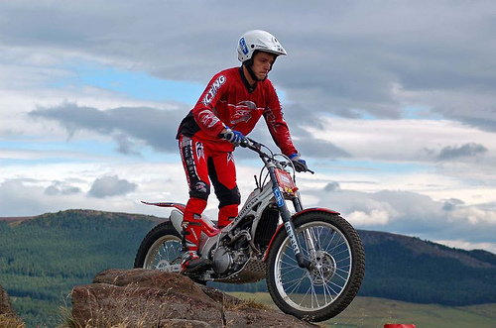
seq2seq learning: visual Q-A
Convolutional Neural Network
what is the man doing ?
Encoder
Decoder
Riding a bike

Slide 7
seq2seq learning: Image-captioning
<start> A man in a white helmet is riding a bike
Decoder
Encoder
<start> A man in a white helmet is riding a bike

Slide 8
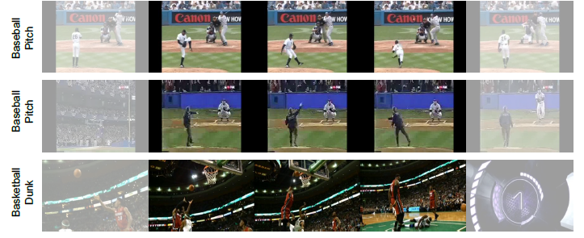
seq2seq learning: video action classification
NO ACTION
pitching
pitching
pitching
NO ACTION
Decoder
Encoder

Slide 9
Seq2seq learning: put it together
One Output
Many Output
One Output
One Input
One Input
Many Input
Image
Classification
Image
Captioning
Sentiment
Analysis

Slide 10
Seq2seq learning: put it together
Many Output
Many Output
Many Input
Many Input
Machine
Translation
Video
Storyline

Slide 11
提纲
序列学习概念：sequence to sequence(Seq2Seq) learning
序列学习若干方法
若干研究与思考

Slide 12
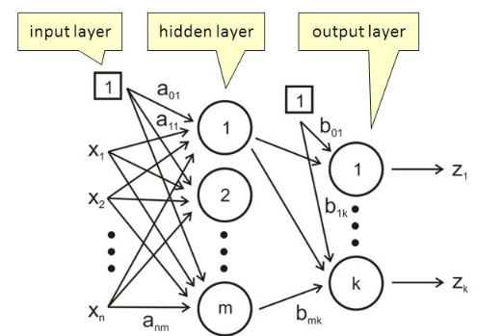
Basic models
From multilayer perceptron (MLP) to Recurrent Neural Network to LSTM/GRU
Multi-Layer Perceptron(MLP) is by nature a feedforward directed acyclic network (Feed-forward neural network).
  An MLP consists of multiple layers and can map input data to output data via a set of nonlinear activation functions. MLP utilizes a supervised learning technique called backpropagation for training the network.
non-linear
end-to-end
differentiable
sequential
Input
Mapping
Output

Slide 13
Basic models
前向神经网络在刻画数据分布方面的作用：
universal approximation theorem
A feed-forward network with a single hidden layer containing a finite number of neurons (i.e., a multilayer perceptron), can approximate continuous functions on compact subsets of R^{n}, under mild assumptions on the activation function. The theorem thus states that simple neural networks can represent a wide variety of interesting functions when given appropriate parameters; however, it does not touch upon the algorithmic learnability of those parameters. One of the first versions of the theorem was proved by George Cybenko in 1989 for sigmoid activation functions.
Balázs Csanád Csáji, Approximation with Artificial Neural Networks, Faculty of Sciences; Eötvös Loránd University, Hungary
Cybenko., G. , Approximations by superpositions of sigmoidal functions, Mathematics of Control, Signals, and Systems, 2 (4), 303-31,1989
Kurt Hornik,Approximation Capabilities of Multilayer Feedforward Networks, Neural Networks, 4(2), 251–257,1991

Slide 14
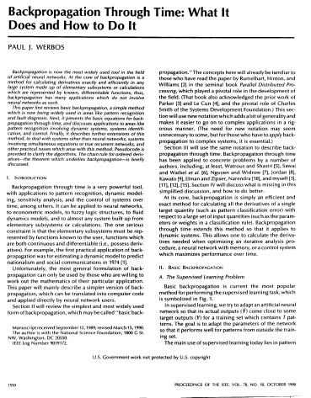
Basic models
Backpropagate errors (误差后向传播)
Paul J. Werbos (born 1947) is a scientist best known for his 1974 Harvard University Ph.D. thesis, which first described the process of training artificial neural networks through backpropagation of errors. The thesis, and some supplementary information, can be found in his book, The Roots of Backpropagation (ISBN 0-471-59897-6). He also was a pioneer of recurrent neural networks.
Werbos was one of the original three two-year Presidents of the International Neural Network Society (INNS). He was awarded the IEEE Neural Network Pioneer Award for the discovery of backpropagation and other basic neural network learning frameworks such as Adaptive Dynamic Programming.
Paul J. Werbos, Backpropagation Through Time: What It Does and How to Do It, Proceedings of the IEEE, 78(10):1550-1560,1990

Slide 15
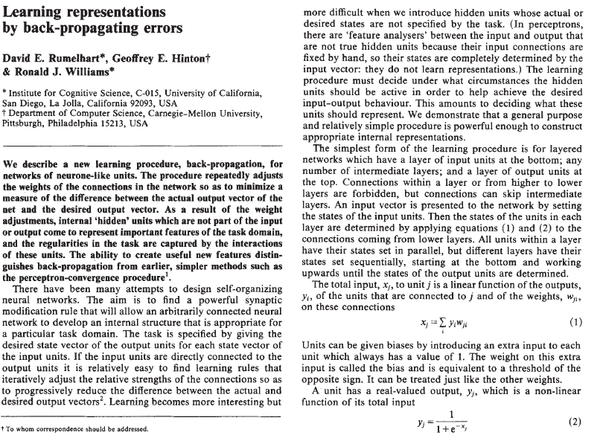
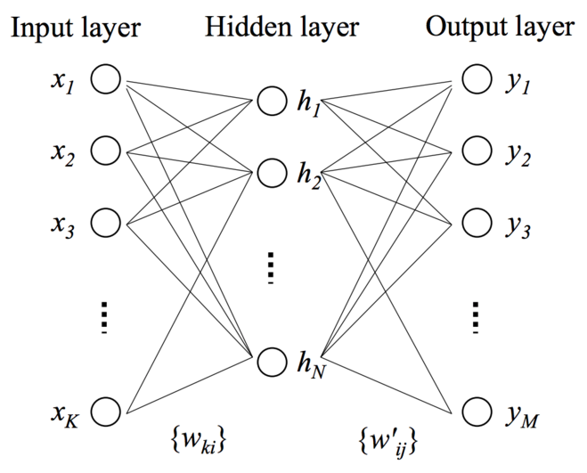
Basic models
Backpropagate errors
(误差后向传播)
Repeatedly adjusts the weights of the connections in the network so as to minimize the measure of the difference between the actual output vector of the net and the desired output vector. As a result of the weight adjustments, internal "hidden" units which are not part of the input or output come to represent important features of the task domain, and the regularities in the task are captured by the interactions of these units.
Rumelhart, David E.; Hinton, Geoffrey E.; Williams, Ronald J., Learning representations by back-propagating errors, Nature, 323 (6088): 533–536,1986

Slide 16
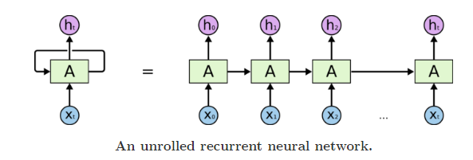
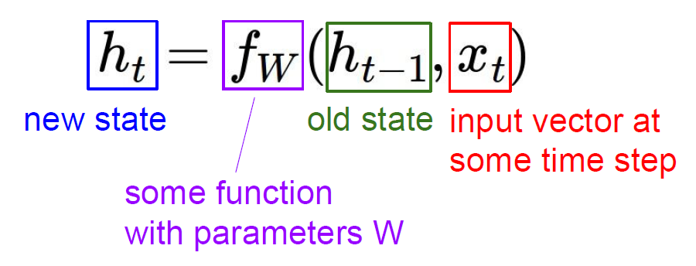
Basic models
From multilayer perceptron (MLP) to Recurrent Neural Network to LSTM/GRU
Recurrent Neural Network: An RNN has recurrent connections (connections to previous time steps of the same layer).
RNN are powerful but can get extremely complicated. Computations derived from earlier input are fed back into the network, which gives RNN a kind of memory.
Standard RNNs suffer from both exploding and vanishing gradients due to their iterative nature.
sequence input
(x0…xt)
Mapping
Embedding vector
(ht)

Slide 17
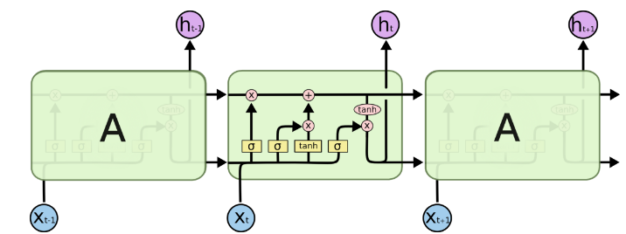
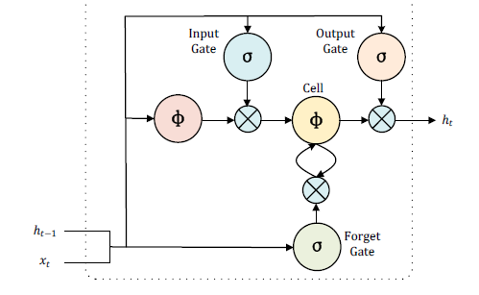
Basic models
Long Short-Term Memory (LSTM) Model:
  LSTM is an RNN devised to deal with exploding and vanishing gradient problems in RNN.
  An LSTM hidden layer consists of a set of recurrently connected blocks, known as memory cells.
  Each of memory cells is connected by three multiplicative units - the input, output and forget gates.
  The input to the cells is multiplied by the activation of the input gate, the output to the net is multiplied by the output gate, and the previous cell values are multiplied by the forget gate.
Sepp Hochreiter &Jűrgen Schmidhuber, Long short-term memory, Neural computation, Vol. 9(8), pp. 1735--1780, MIT Press, 1997

Slide 18
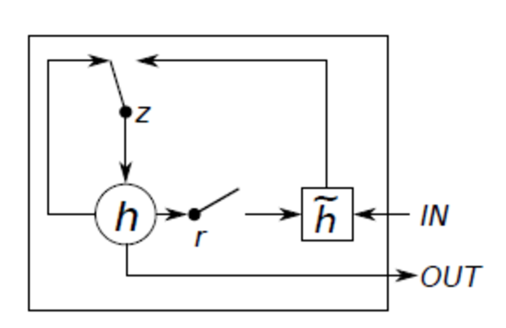





Basic models
Gated Recurrent Unit (GRU)
Gated recurrent units are a gating mechanism in recurrent neural networks, GRU has fewer parameters than LSTM, as they lack an output gate.
z_{t} =$σ$(W_{z}x_{t}+U_{z}h_{t-1})
$\tilde{h}$_{t} = tanh(Wx_{t}+U(r_{t} h_{t-1}))
r_{t} = $σ$(W_{r}x_{t}+U_{r}h_{t-1})
h_{t}=(1-z_{t})h_{t-1}+z_{t}$\tilde{h}$_{t}
Chung, Junyoung; Gulcehre, Caglar; Cho, KyungHyun; Bengio, Yoshua (2014), Empirical Evaluation of Gated Recurrent Neural Networks on Sequence Modeling. arXiv:1412.355

Slide 19
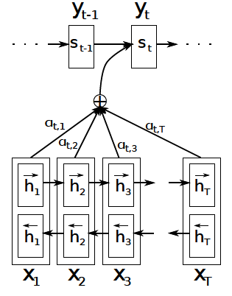
Learning with attention/ internal memory
“The behavior of the computer at any moment is determined by the symbols which he is observing and his 'state of mind' at that moment.” – Alan Turing
输出序列
在输出序列中，每一时刻的输出依赖于所有输入数据当时时刻的编码
输入序列

Slide 20
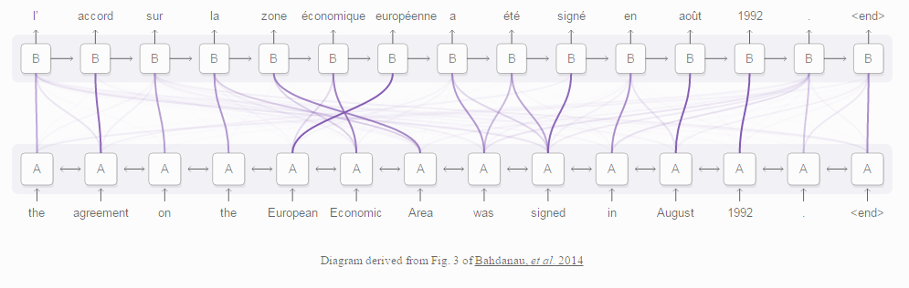
Learning with attention/ internal memory
Neural Machine Translation by Jointly Learning to Align and Translate, ICLR 2015

Slide 21
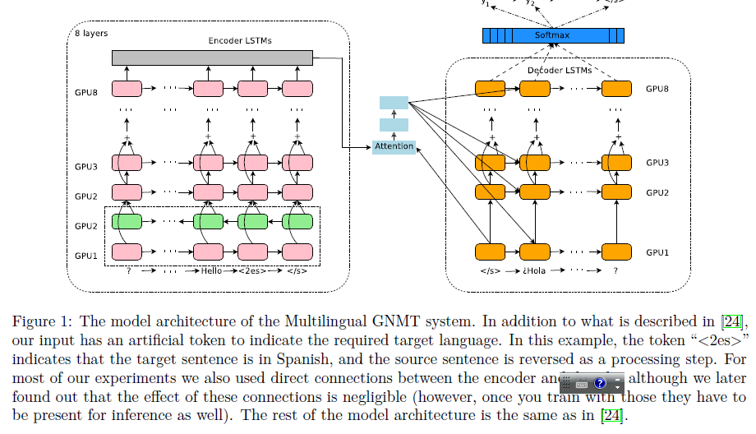
Learning with attention/ internal memory
Google's Neural Machine Translation System: Bridging the Gap between Human and Machine Translation
Google’s Multilingual Neural Machine Translation System Enabling zero-shot translation

Slide 22
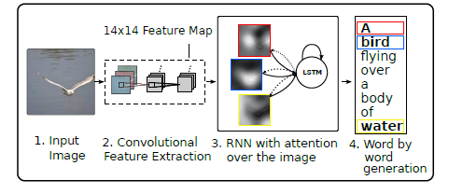

Learning with attention/ internal memory
context vector Zt
Deterministic “Soft” Attention via end-to-end learning
Kelvin Xu, Jimmy Ba, Ryan Kiros, Kyunghyun Cho, Aaron Courville, Ruslan Salakhudinov, Rich Zemel and Yoshua Bengio, Show, Attend and Tell: Neural Image Caption Generation with Visual Attention, ICML 2015

Slide 23
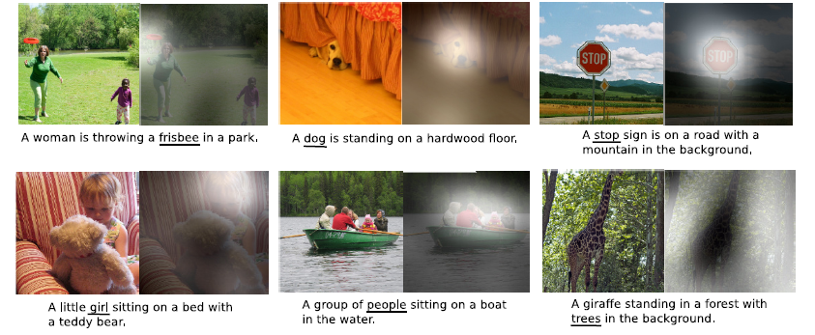
Learning with attention/ internal memory
Kelvin Xu, Jimmy Ba, Ryan Kiros, Kyunghyun Cho, Aaron Courville, Ruslan Salakhudinov, Rich Zemel and Yoshua Bengio, Show, Attend and Tell: Neural Image Caption Generation with Visual Attention, ICML 2015

Slide 24
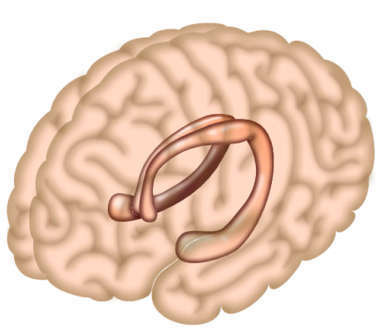
Learning with external memory
人类大脑中的海马体：先验和知识的储存体

Slide 25
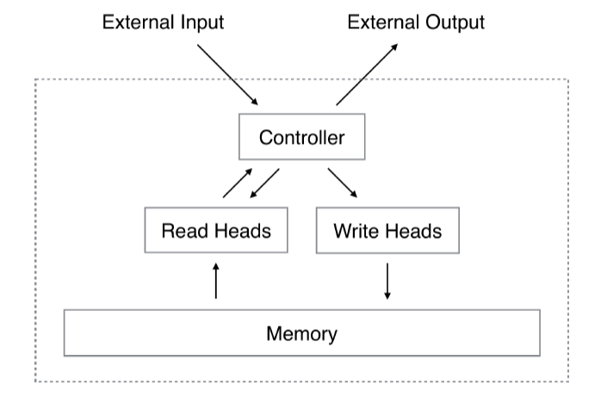

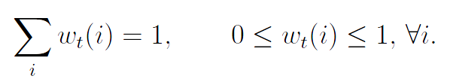


Learning with external memory
Neural Turing Machines
Reading
Writing
Graves A, Wayne G, Danihelka I. Neural Turing Machines,arXiv preprint arXiv:1410.5401, 2014, DeepMind
J. Weston, S. Chopra, A. Bordes. Memory Networks. ICLR 2015 (and arXiv:1410.3916, Facebook AI)

Slide 26
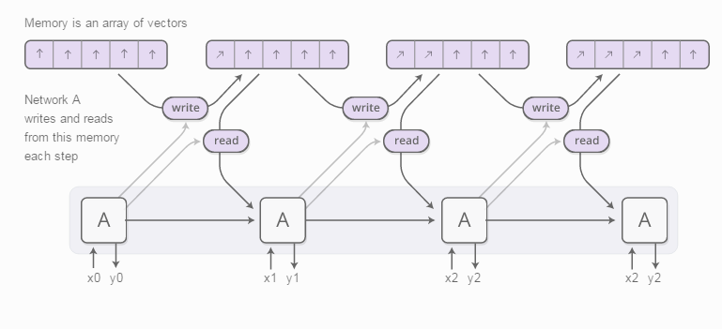
Learning with external memory
Neural Turing Machines

Slide 27
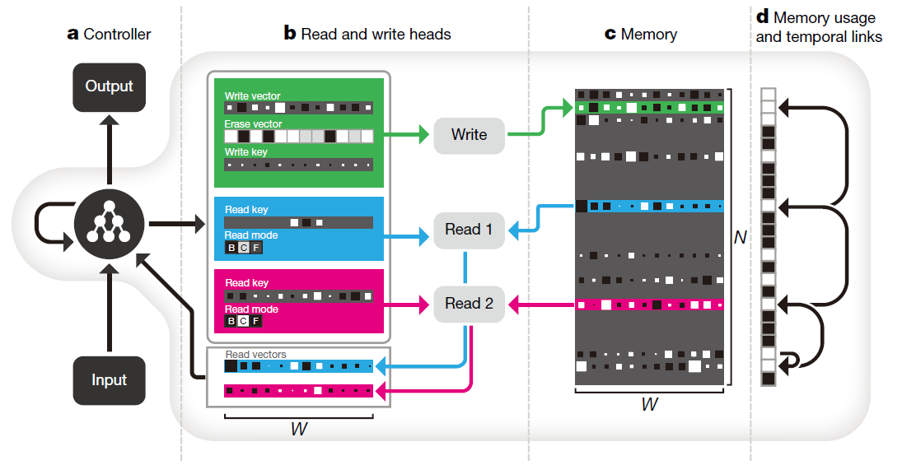
Learning with external memory
可微分神经计算机(differentiable neural computer，DNC)：
  An achievement that has potential implications for the neural–symbolic integration problem(神经网络-符号计算的统一)
  Deep neural reasoning and one-shot learning
Graves, Alex, et al. "Hybrid computing using a neural network with dynamic external memory." Nature 538.7626 (2016): 471-476.

Slide 28
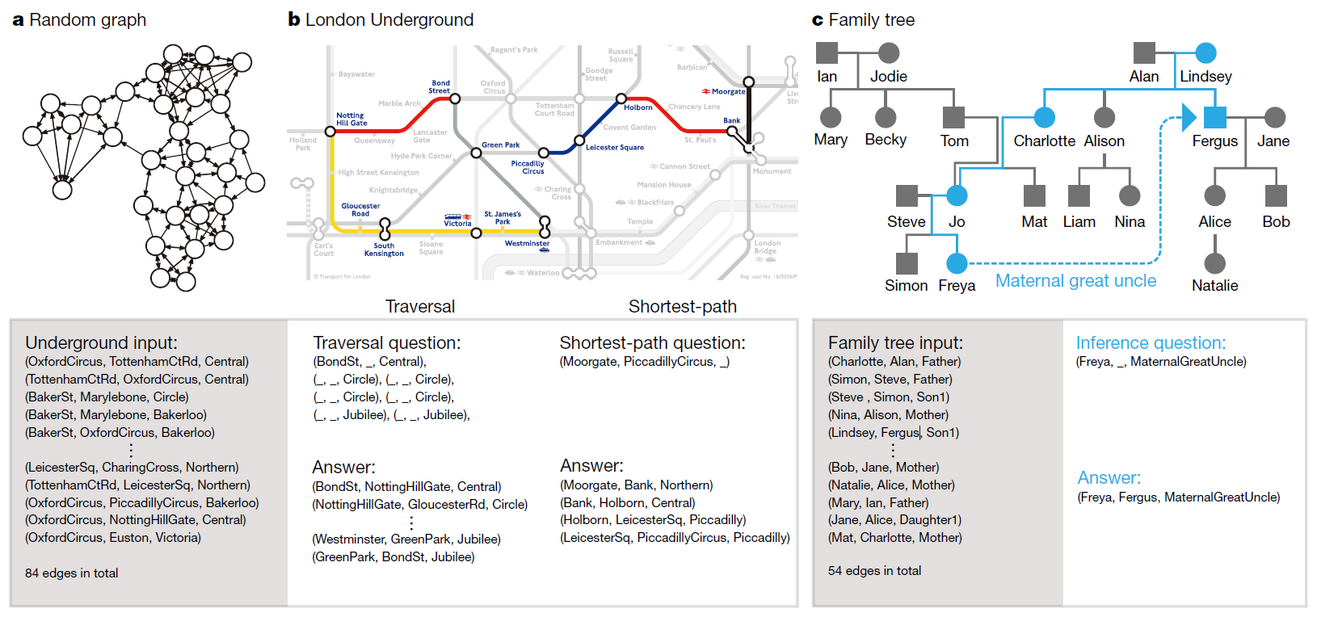
Learning with external memory
Deep neural reasoning
(连续空间模型与离散空间模型相互协调的搜索与决策)

Slide 29
Learning with external memory
Learning of Basic Algorithms using Reasoning, Attention, Memory (RAM)
Methods include adding stacks and addressable memory to RNNs:
“Neural Net Architectures for Temporal Sequence Processing.” M. Mozer.
“Neural Turing Machines” A. Graves, G. Wayne, I. Danihelka.
“Inferring Algorithmic Patterns with Stack Augmented Recurrent Nets.” A. Joulin, T. Mikolov.
“Learning to Transduce with Unbounded Memory” E. Grefenstette et al.
“Neural Programmer-Interpreters” S. Reed, N. de Freitas.
“Reinforcement Learning Turing Machine.” W. Zaremba and I. Sutskever.
“Learning Simple Algorithms from Examples” W. Zaremba, T. Mikolov, A. Joulin, R. Fergus.
“The Neural GPU and the Neural RAM machine” I. Sutskever.

Slide 30
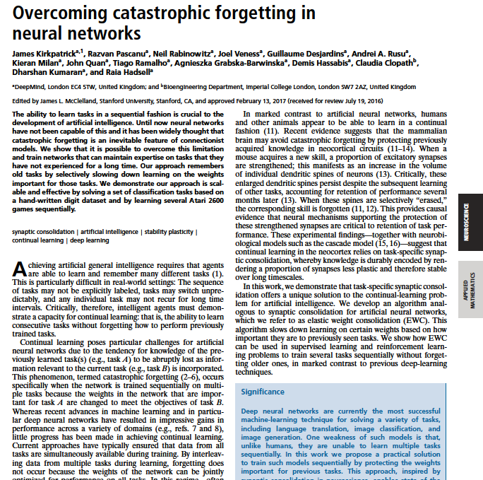
Gives memory to AI
DeepMind crafted an algorithm that lets a neural network 'remember' past knowledge and learn more effectively. The approach is similar to how your own mind works, and might even provide insights into the functioning of human minds.
Much like real synapses, which tend to preserve connections between neurons when they've been useful in the past, the algorithm (known as Elastic Weight Consideration) decides how important a given connection is to its associated task
James Kirkpatrick, Razvan Pascanu, et al., Overcoming catastrophic forgetting in neural network, PNAS, http://www.pnas.org/cgi/doi/10.1073/pnas.1611835114

Slide 31
提纲
序列学习概念：sequence to sequence(Seq2Seq) learning
序列学习若干方法
知识计算引擎：从大数据到知识

Slide 32

知识计算引擎: KS-Studio
http://www.ksstudio.org/

Slide 33
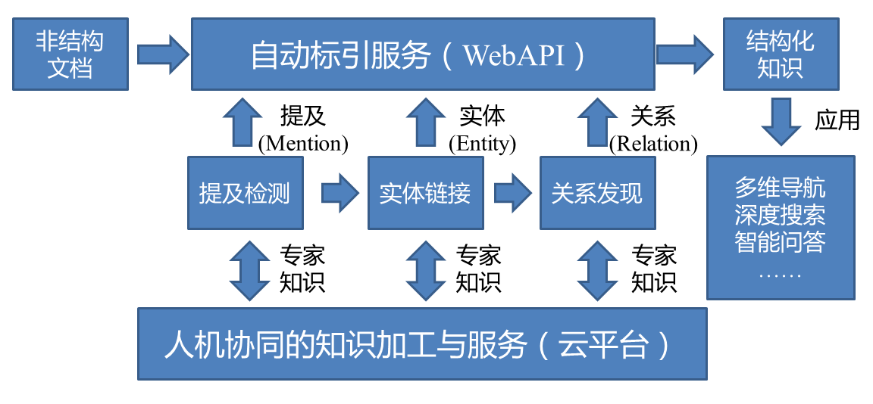
知识计算引擎: KS-Studio
KS-Studio 技术框架

Slide 34
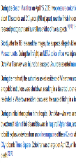

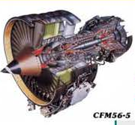





知识计算引擎: KS-Studio
实体、属性、
关系
数据驱动机器学习
实体
直觉与经验
个体内隐知识模型
(crowd model)
知识图谱
众包数据中
弱标注信息
在数据驱动机器学习中引入“众包数据”或“知识规则”，拓展单纯数据驱动的概念识别手段，建立解释性强的人工智能方法。

Slide 35
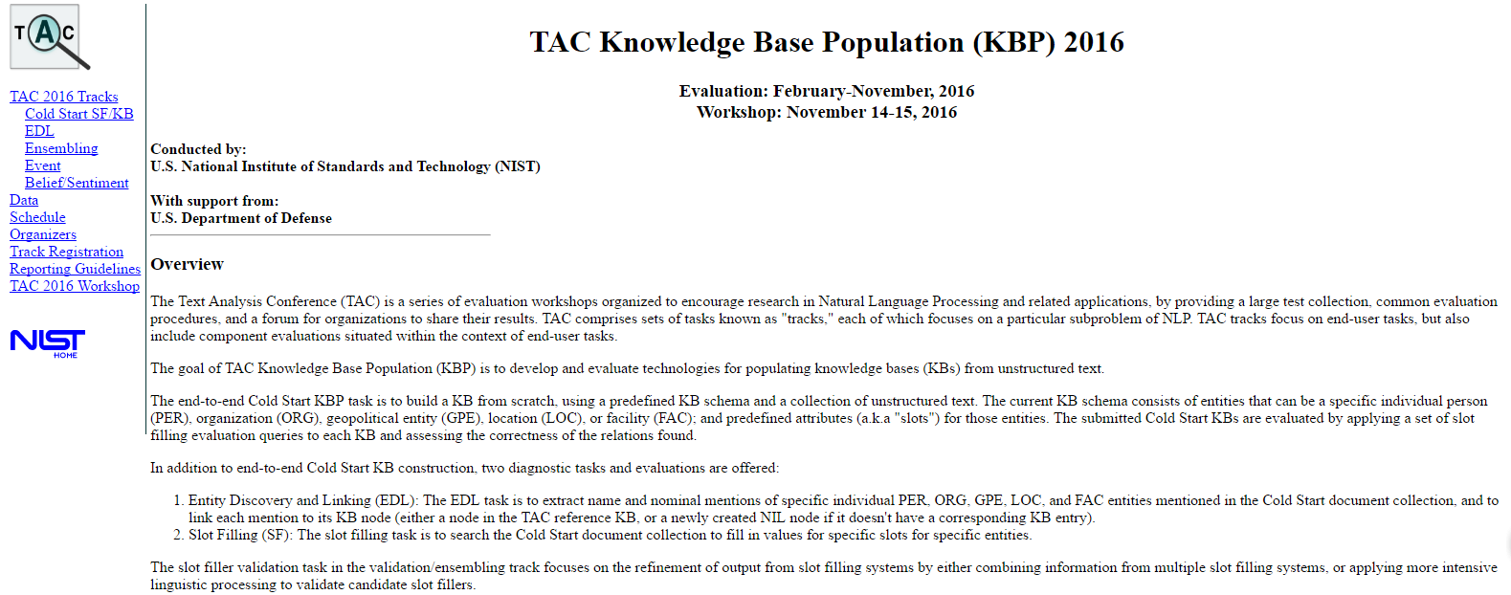
TAC Knowledge Base Population (KBP) 2016

Slide 36
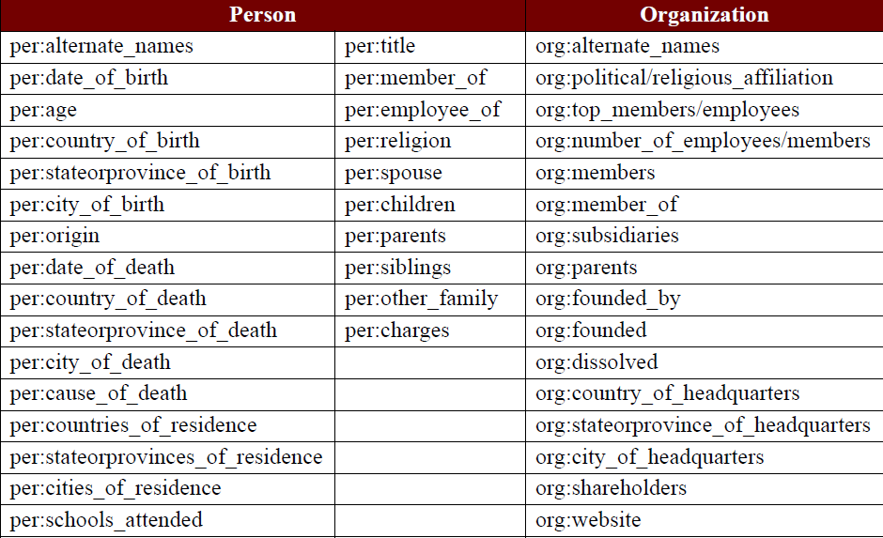
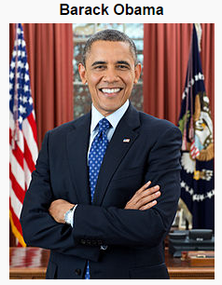
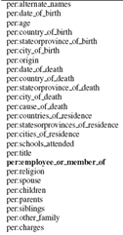

TAC Knowledge Base Population (KBP) 2016
Task 1： Cold Start KBP
The Cold Start KBP track builds a knowledge base from scratch using a given document collection and a predefined schema for the entities and relations that will comprise the KB. In addition to an end-to-end KB Construction task, Cold Start KBP includes a Slot Filling (SF) task to fill in values for predefined slots (attributes) for a given entity.
Person and Organization)

Slide 37
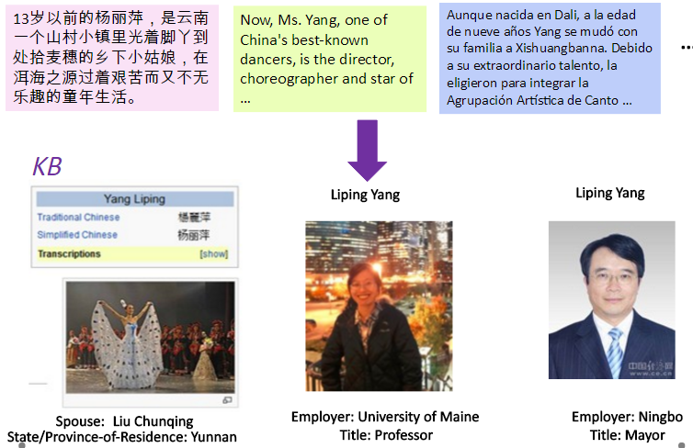
TAC Knowledge Base Population (KBP) 2016
Task 2： Entity Discovery and Linking (EDL)
The Entity Discovery and Linking (EDL) track aims to extract entity mentions from a source collection of textual documents in multiple languages (English, Chinese, and Spanish), and link them to an existing Knowledge Base (KB); an EDL system is also required to cluster mentions for those entities that don't have corresponding KB entries.

Slide 38
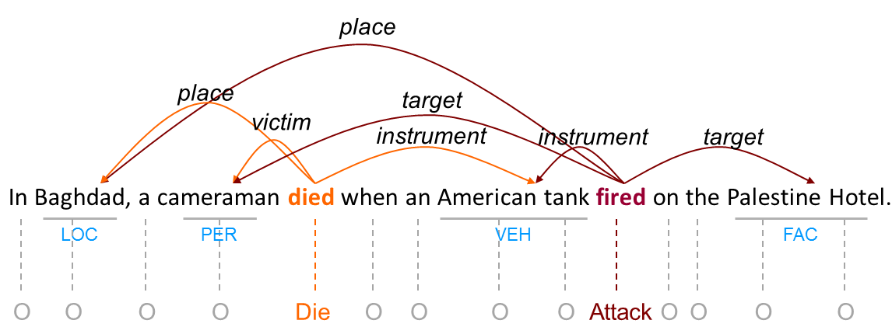
TAC Knowledge Base Population (KBP) 2016
Task 3: Event Track
The goal of the Event track is to extract information about events such that the information would be suitable as input to a knowledge base. The track includes Event Nugget (EN) tasks to detect and link events, and Event Argument (EA) tasks to extract event arguments and link arguments that belong to the same event.

Slide 39
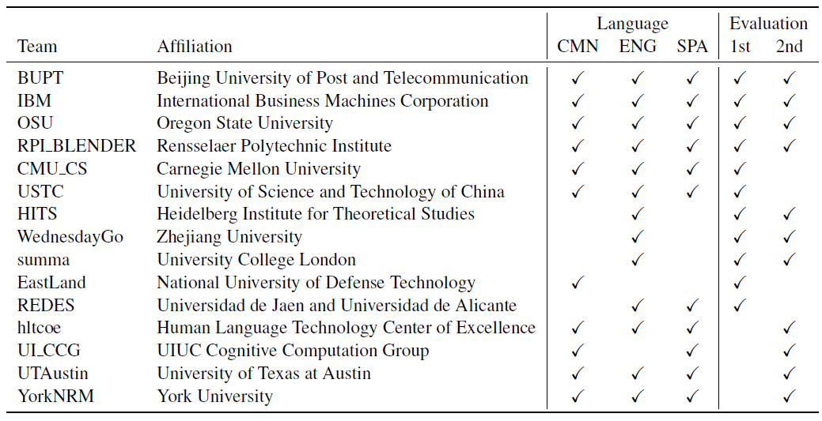
KS-Studio参加KBP知识图谱国际测评
  参赛队伍来自CMU、UIUC 、 IBM、UCL 、科大讯飞、浙江大学、北邮等15个国内外知名高校与研究机构。
参赛队伍信息

Slide 40
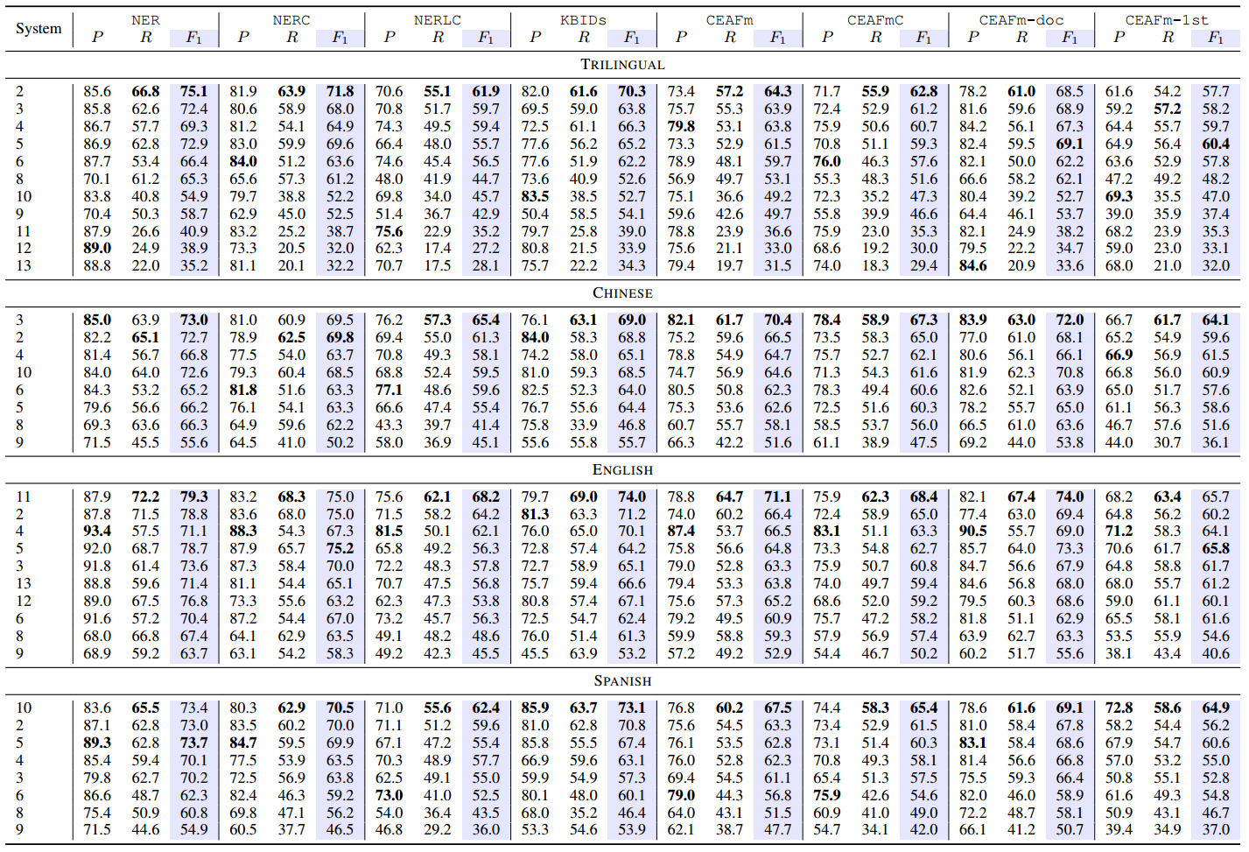
KS-Studio参加KBP知识图谱国际测评
KBP 2016 提及检测任务（Mention Detection）参赛队伍成绩
  浙江大学获得综合排名第一
  3个指标中2项第一，1项并列第二

Slide 41
KS-Studio参加KBP知识图谱国际测评
KBP 2016 实体链接任务（Entity Linking）参赛队伍成绩
  浙江大学关键技术组获得综合排名第一
  5个指标中4项第一，1项第二

Slide 42

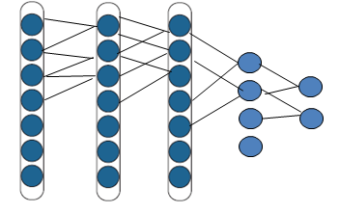
KS-Studio：关系挖掘(Relation Discovery)
训练：根据标注的样本，训练卷积网络和分类器
预测：提取句子中命名实体对，进行关系预测
Carbonate may be a factor in the increasing incidence of heart disease.
正样本
Lithium also causes cyanosis during early pregnancy
Flumazenil was well tolerated, with no movement disorders reported
向量化表述
负样本
Thromboembolism is a recognized complication of heparin therapy
A 2-year-old child with known neurologic impairment developed a dyskinesia soon after starting phenobarbital therapy for seizures. Known causes of movement disorders were Phenobarbital and could be eliminated after evaluation. Dexmedetomidine is useful as the sole sedative for pediatric MRI.
Dexmedetomidine is useful as the sole sedative for pediatric MRI.
Known causes of movement disorders were Phenobarbital and could be eliminated after evaluation.
Drug-induced-Disease:
(Phenobarbital, movement disorders)

Slide 43
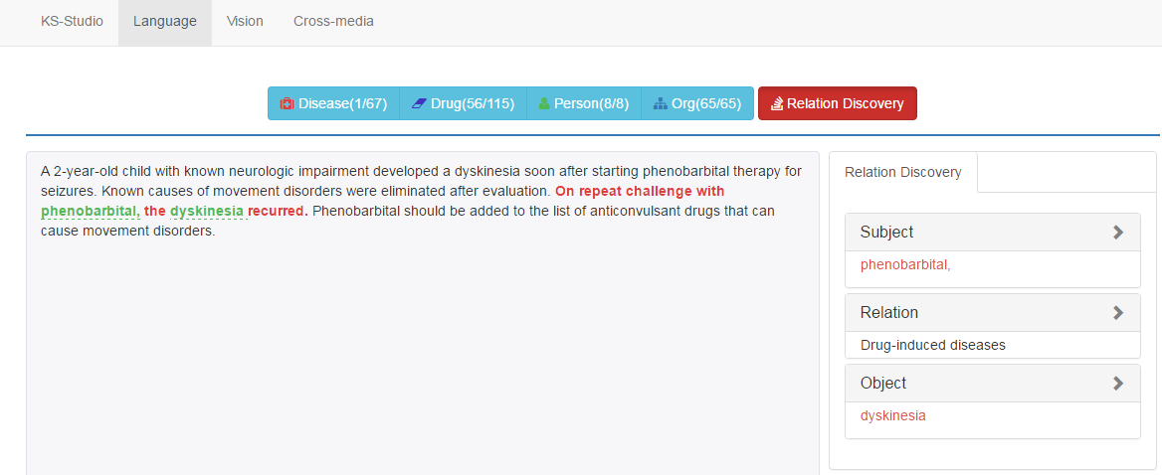
KS-Studio：关系挖掘(Relation Discovery)
以Drug-induced-Disease关系提取为例
(Phenobarbital, dyskinesia)
苯巴比妥造成运动障碍

Slide 44
KS-Studio：Q-A问答
利用社交网络、专家模型、答案时序信息来作为问答匹配的辅助信息，从而提高深度问答匹配的效果。
专家推荐
测试数据
完成学习后的
深度神经网络
短文本排序
用户满意度预测
训练
……
大量问答对
深度神经网络模型
提取
用户社交网络
答案时序信息
其他信息

Slide 45
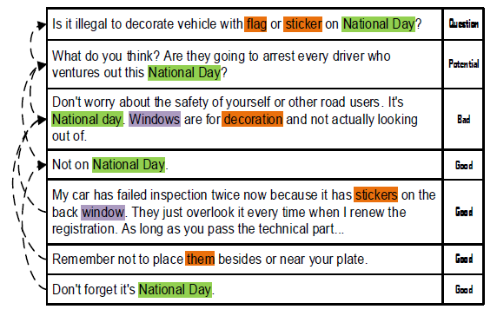
KS-Studio：Q-A问答
在Q-A问答中刻画因果依赖和时序影响机制
能用众力，则无敌于天下矣；能用众智，则无畏于圣人矣(语出《三国志·吴志·孙权传》)
Q-A问答中观点逐步凝练形成

Slide 46
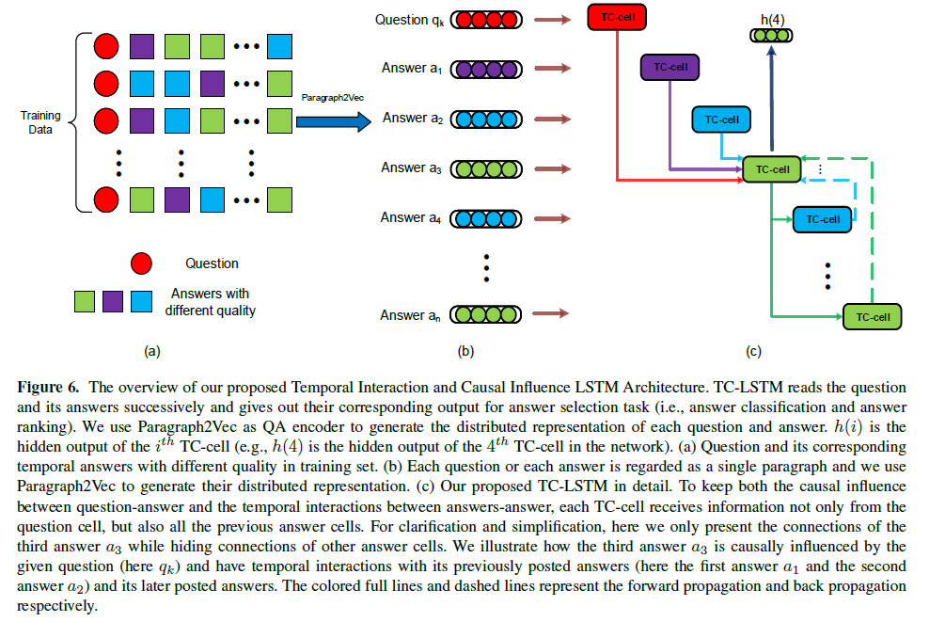
KS-Studio：Q-A问答
Fei Wu, Xinyu Duan, Jun Xiao, Zhou Zhao, Siliang Tang, Yin Zhang, and Yueting Zhuang, Temporal Interaction and Causation Influence in Community-based Question Answering, IEEE Transactions on Knowledge and Data Engineering (major revised)

Slide 47
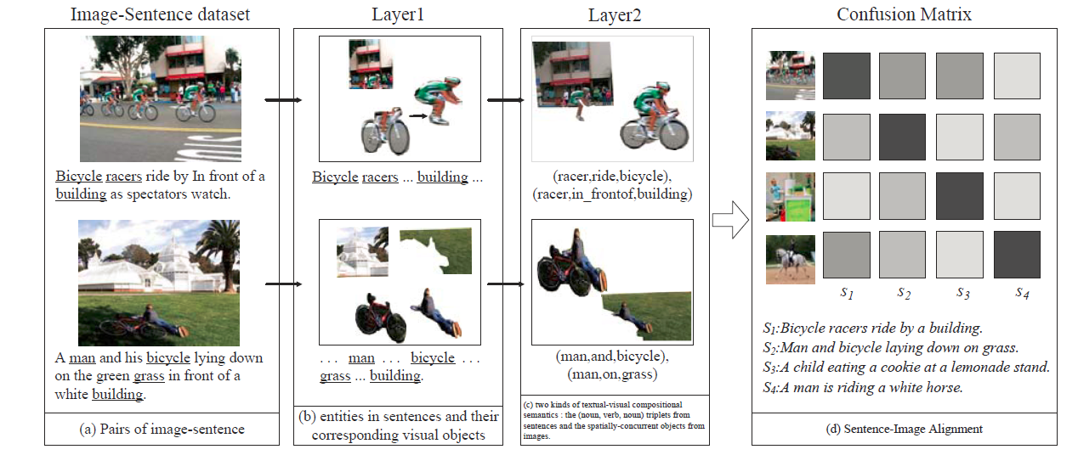
KS-Studio：看图说话
对图像-句子等耦合数据生成组合语义，在层次化深度学习框架下实现“看图说话”
Yueting Zhuang, Jun Song, Fei Wu, Xi Li, Zhongfei Zhang, Rui Yong, Multi-modal Deep Embedding via Hierarchical Grounded Compositional Semantics, IEEE Transactions on Circuits and Systems for Video Technology, 10.1109/TCSVT.2016.2606648

Slide 48
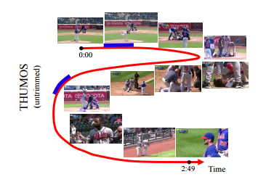
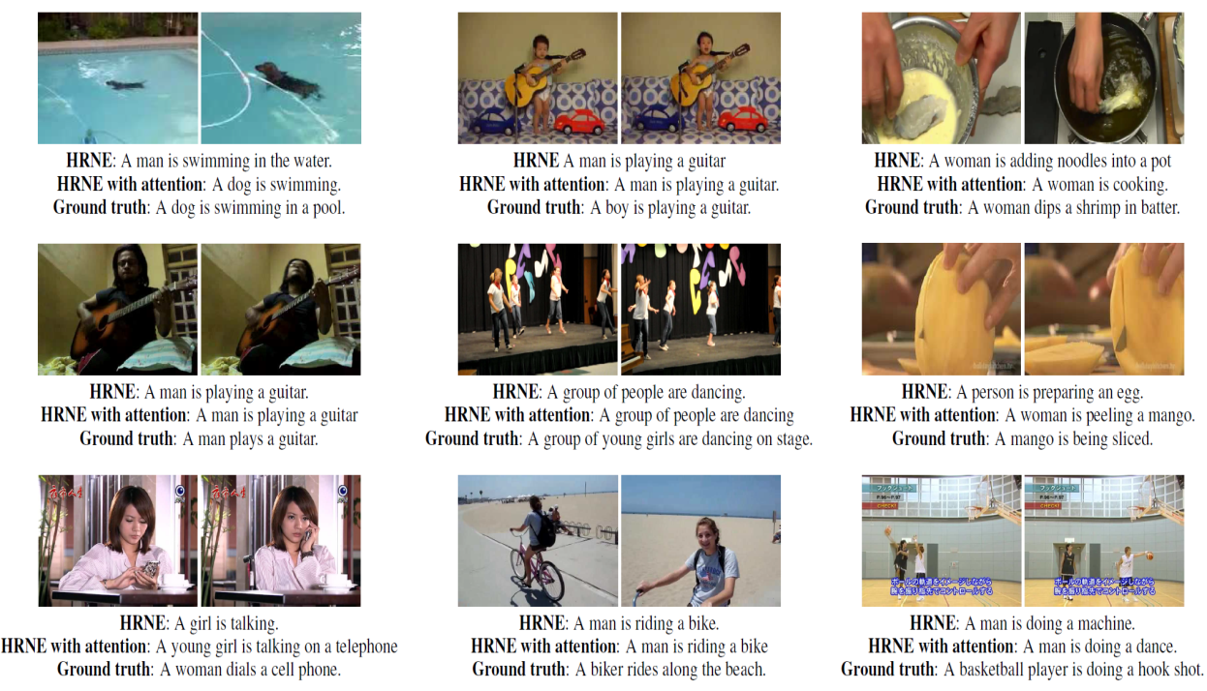
KS-Studio：运动识别
视频事件检测之一及Video-Captioning
国际视频运动行为识别竞赛Thumos Challenge 2015第三名，Thumos包含了101个视频运动类别
2016 ActivityNet视频运动行为识别竞赛第六名
Pingbo Pan, Zhongwen Xu, Yi Yang, Fei Wu, Yueting Zhuang, Hierarchical Recurrent Neural Encoder for Video Representation with Application to Captioning, CVPR 2016, 1029-1038

Slide 49
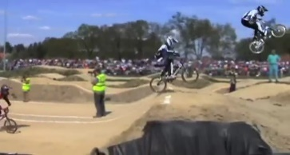
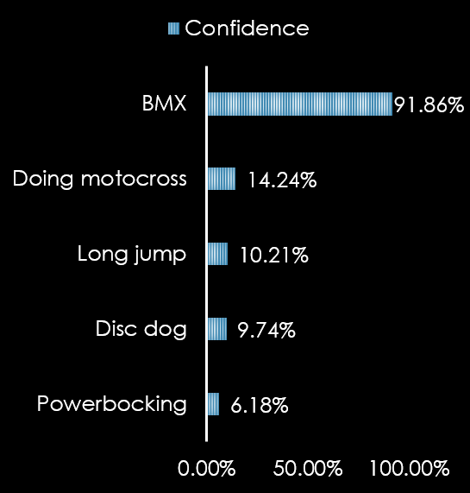
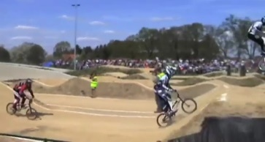
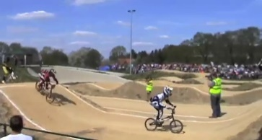
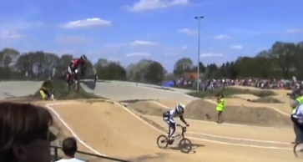
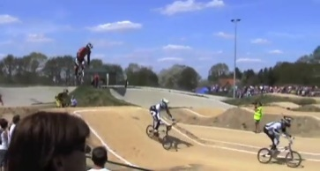
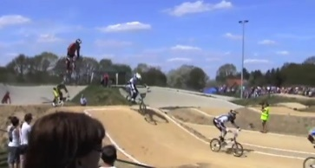
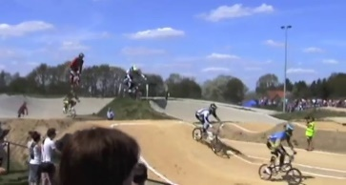

KS-Studio：运动识别
Video
Recognition System
Real-time
video stream
Recognition
results

Slide 50
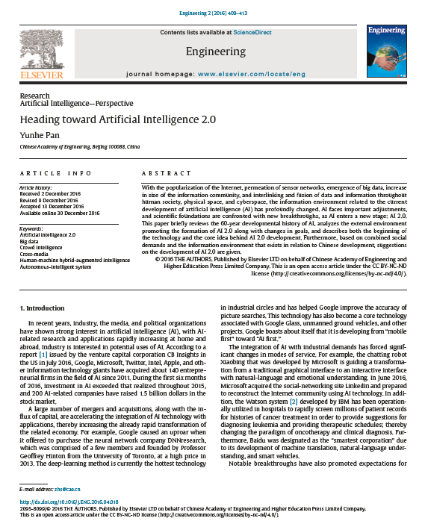

总结：迈向人工智能2.0
Pan, Yunhe, 2016, Heading toward artificial intelligence 2.0,
Engineering, 409-413

Slide 51

总结：迈向人工智能2.0
Yueting Zhuang, Fei Wu, Chun Chen, Yunhe Pan, Challenges and Opportunities: From Big Data to Knowledge in AI 2.0,Frontiers of Information Technology & Electronic Engineering, 2017,18(1):3-14

Slide 52
谢谢大家
Email: wufei@cs.zju.edu.cn

