Slide 1

Learning to Test Compilers
编译器技术交流会2017
郝丹，北京大学
haodan@pku.edu.cn

Slide 2
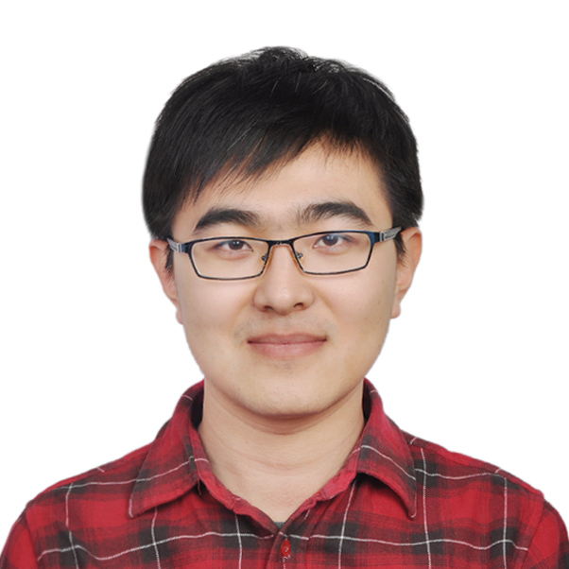

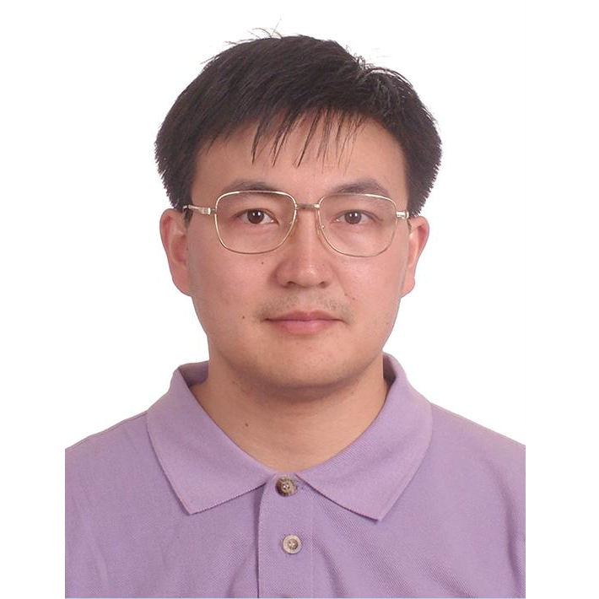

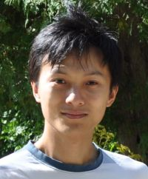

Most People Involved
陈俊洁
胡文翔
王冠成
张路
郝丹
熊英飞
张宏宇

Slide 3
Typical Software Testing Process
Software
Execute
Test Input
Expected Output
Actual Output
Test Case
Compare
revealed
faults
no revealed faults

Slide 4
Start of Our Compiler Testing Research
2015, we read Professor Su’s paper on EMI and started our work accordingly
Compilers
Execute
Test Input
Expected Output
Actual Output
Test Case
Compare
revealed
faults
no revealed faults

Slide 5
Start：
Empirical Study on Compiler Testing
Given the testing time：
GCC
LLVM
…
Notes:
我们组的工作是从2015年开始，研究工作的第一步是实证研究编译器测试现状

Slide 6
Given the testing time：
Test Input
GCC
LLVM
…
Test Oracle
Notes:
针对GCC和LLVM，我们从多个角度，考虑不同类型的测试输入和测试预言，研究他们的测试效果。测试预言，是。。。

Slide 7
Given the testing time：
Test Input
GCC
LLVM
…
Test Oracle
RDT
DOL
EMI

Slide 8
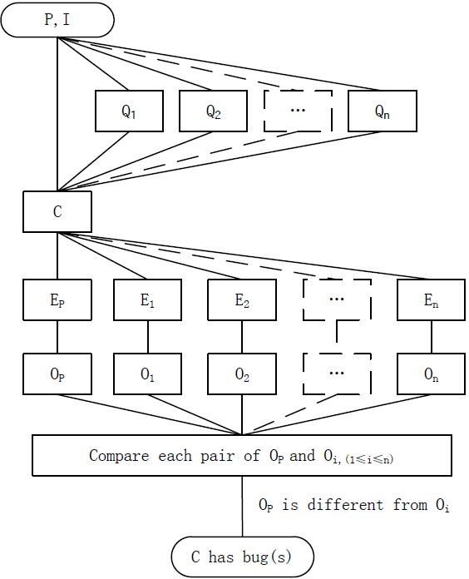
Equivalence Modulo Inputs
Comparison between a test program and its variants whose behaviors are regarded as equivalent under a set of test inputs for this test program
EMI^{[2]}
main(){
int x=1;
if(x==1)
printf(“x=1”);
if(x==2)
printf(“x=2”);
…
}
main(){
int x=1;
if(x==1)
printf(“x=1”);
if(x==2)
printf(“x=2”);
…
}
P
Q_{i}
Test Oracle:
Program and its variants with equivalent behaviors under some test inputs
[2] V. Le, M. Afshari, Z. Su. Compiler validation via equivalence modulo inputs, PLDI, 2014.

Slide 9
Given the testing time：
Test Input
Test programs by Csmith
Test programs by EMI
GCC
LLVM
…
Test Oracle
RDT
DOL
EMI

Slide 10
Given the testing time：
Test Input
#bugs
Test programs by Csmith
#bug/ 10 hours
#unique bugs
Test programs by EMI
Time detecting the 1st bug
GCC
LLVM
…
Test Oracle
RDT
DOL
EMI

Slide 11
Given the testing time：
Test Input
#bugs
Test programs by Csmith
#bug/ 10 hours
#unique bugs
Test programs by EMI
Time detecting the 1st bug
GCC
LLVM
…
Test Oracle
#optimization related bugs
RDT
#optimization irrelevant bugs
DOL
EMI

Slide 12
Given the testing time：
Test Input
#bugs
Test programs by Csmith
#bug/ 10 hours
#unique bugs
Test programs by EMI
Time detecting the 1st bug
GCC
LLVM
…
Test Oracle
#optimization related bugs
RDT
#optimization irrelevant bugs
DOL
#test programs
EMI

Slide 13
Foundation of Compiler Testing Research: Measurement
Test Input
#bugs
Test programs by Csmith
#bug/ 10 hours
#unique bugs
Test programs by EMI
Time detecting the 1st bug
GCC
LLVM
…
Test Oracle
#optimization related bugs
RDT
#optimization irrelevant bugs
DOL
#test programs
EMI

Slide 14

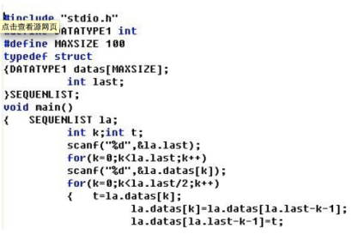

Measurement：Ideal V.S. Reality
Ideal:
number of detected bugs
Two Alternative Measurements
Number of bugs manually identified
Scalability Problem

Slide 15

Measurement：Ideal V.S. Reality
Ideal:
number of detected bugs
Two Alternative Measurements
Number of test programs triggering bugs
Highly Inaccurate
manually check five commits of GCC, each of which fixes only one GCC bug

Slide 16
A New Measurement Is Needed!
Ideal:
number of detected bugs
Two Alternative Measurements
Number of bugs manually identified
Scalability Problem
Number of test programs triggering bugs
Highly Inaccurate

Slide 17
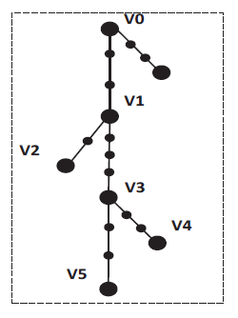
New Measurement：Correcting Commits
For any test program triggering a bug of a compiler C whose commit version is x (e.g., V0)
check subsequent commits of the compiler and determine which commit corrects the bug.
Same Bug:
the version triggering the bug
the version correcting the bug

Slide 18
Empirical Study
Test Input
Measurement
Test programs by Csmith
#bugs
#bug/ 10 hours
Test programs by EMI
#unique bugs
GCC
LLVM
Time detecting the 1st bug
Test Oracle
RDT
#optimization related bugs
DOL
#optimization irrelevant bugs
EMI
#test programs

Slide 19
Some Findings
Some bugs can be triggered by only lower optimization
The existence of many optimization-related bugs
Test programs generated by EMI are also useful for compiler testing
#test program has significant impact on the effectiveness of compiler testing
Junjie Chen, Wenxiang Hu, Dan Hao, Yingfei Xiong, Hongyu Zhang, Lu Zhang, Bing Xie,
An Empirical Comparison of Compiler Testing Techniques, ICSE 2016.

Slide 20
Some Findings
Some bugs can be triggered by only lower optimization
The existence of many optimization-related bugs
Test programs generated by EMI are also useful for compiler testing
#test program has significant impact on the effectiveness of compiler testing
Efficiency Problem！
Junjie Chen, Wenxiang Hu, Dan Hao, Yingfei Xiong, Hongyu Zhang, Lu Zhang, Bing Xie,
An Empirical Comparison of Compiler Testing Techniques, ICSE 2016.

Slide 21


Necessity:
Compiler Testing Acceleration
Compiler Testing
Consuming an extremely long period of time to find a small number of bugs
Yang et al. [1] spent three years on detecting 325 C compiler bugs
Le et al. [2] spent eleven months on detecting 147 C compiler bugs
[1] X. Yang, Y. Chen, E. Eide, and J. Regehr, Finding and understanding bugs in C compilers, PLDI 2011
[2] V. Le, M. Afshari, Z. Su. Compiler validation via equivalence modulo inputs, PLDI, 2014.

Slide 22


How? Test Prioritization
Intuitively
Only a subset of test programs triggering compiler bugs
compiler testing can be accelerated by running these test programs earlier

Slide 23
Applying Prioritization Techniques?
Intuitively
A subset of test programs triggering compiler bugs
Accelerating compiler testing by running these test programs earlier
Test prioritization may be adopted to accelerate compiler testing!
Unfortunately, existing approaches can hardly be used!
Coverage-based: structural coverage information is not available
Input-based: low efficiency and effectiveness

Slide 24
Key: Identifying Test Programs Satisfying…
Identifying
Bug-revealing test programs
Predicting
Execution time of test programs
LET: LEarn to Test compilers

Slide 25
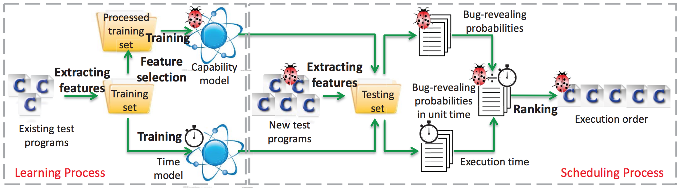
Overview of LET
Learning process: Identifying features, Training a capability model, Training a time model
Scheduling process: Ranking new test programs

Slide 26
Learn: bug-revealing test programs
Whether a compiler bug is triggered:
Elements in test programs
Usage of elements in test programs
Element Features
Statement type
Variable type
Usage Features
Address features
…
Expression type
Operator type
Pointer deference features

Slide 27
Model: bug-revealing test programs
Feature selection
Normalization
Building the capability model
1
2
3
Filter useless features:
>>information gain ratio = 0
Normalize each value of these features into the interval [0, 1]
>> min-max normalization
Use Sequential Minimal Optimization (abbreviated as SMO) algorithm

Slide 28
Learn: execution time of test programs
Same features
Execution time on previous version
Time Model (Regression model)

Slide 29
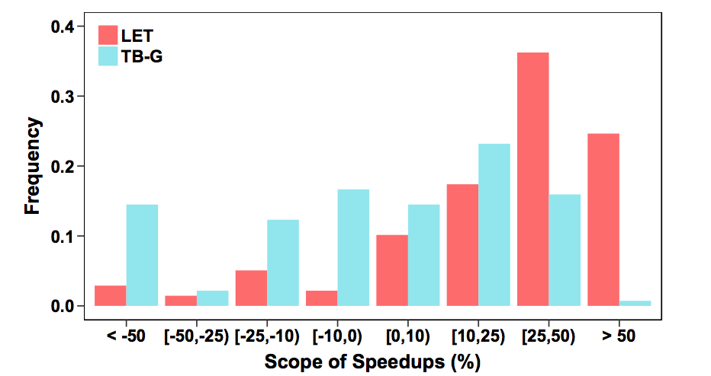
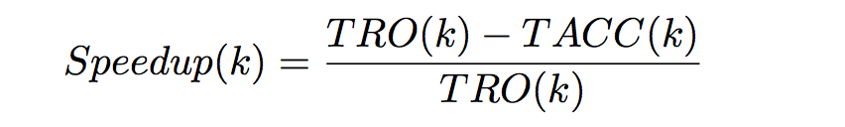
Technique Comparison
1. LET accelerates compiler testing
2. LET perform much better and more stable than TB-G

Slide 30
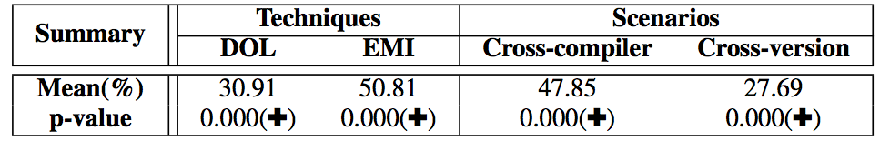
Across Various Usage
1. LET is effective across compiler testing techniques.
2. LET is effective no matter which compiler/version is used in training

Slide 31
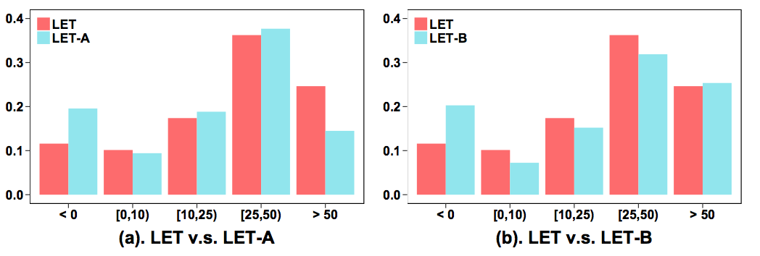
Impact of Various Components
LET-A：去feature selection
LET-B：去time model
Feature selection and time model contribute to LET
Junjie Chen, Yanwei Bai, Hu, Dan Hao, Yingfei Xiong, Hongyu Zhang, Bing Xie,
Learning to Prioritize Test Programs for Compiler Testing, ICSE 2017.

Slide 32
Learn：Presence and Future
Presence
  Empirical study
  Accelerate compiler testing through LET
Future
  Continue: Compiler testing acceleration
    Recognition from the research community？
    Characteristics of compiler bugs (new bug v.s. old bug）
  New problem
    Duplicate bugs
    ……

Slide 33
Learn：Presence and Future
Presence
  Empirical study
  Accelerate compiler testing through LET
Future
  Continue: Compiler testing acceleration
    Recognition from the research community？
    Characteristics of compiler bugs (new bug v.s. old bug）
  New problem
    Duplicate bugs
    ……
Cooperation & Supports

Slide 34
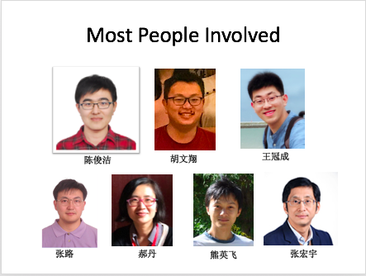
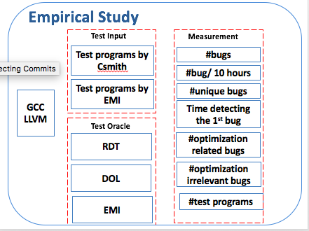
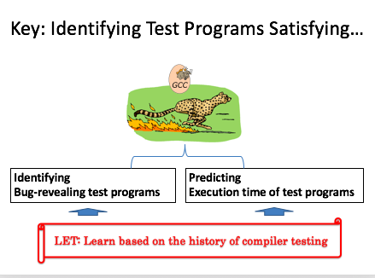
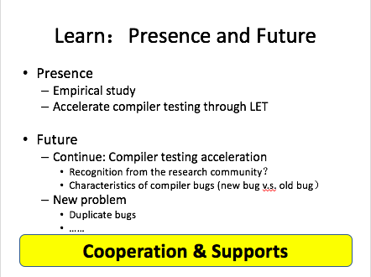

Slide 35
Thank You

